Slide 1
9. Latent Semantic Indexing

Slide 2
Latent Semantic Indexing
Vector space retrieval is vague and noisy
Based on index terms
Unrelated documents might be included in the answer set
apple (company) vs. apple (fruit)
Relevant documents that do not contain at least one index term are not retrieved
car vs. automobile
Observation
The user information need is more related to concepts and ideas than to index terms
Notes:
Despite its success and widespread use the vector space retrieval model suffers from some problems. The important insight is that terms may indicate a concept a user is interested in, but there does not necessarily exist a one to one correspondence between terms and concepts. As a consequence retrieval results may contain irrelevant documents, and relevant documents may be missed.

Slide 3
The Problem
Vector Space Retrieval handles poorly the following two situations
1. Synonymy: different terms refer to the same concept, e.g. car and automobile
Result: poor recall
2. Homonymy: the same term may have different meanings, e.g. apple, model, bank
Result: poor precision
Notes:
These problems are related to the fact that the same concepts can be expressed through many different terms (synonyms) and that the same term may have multiple meanings (homonyms). Studies show that different users use the same keywords for expressing the same concepts only 20% of the time.

Slide 4
Example: 3 documents
doc₁
doc₂
doc₃
apple blackberry orange vitamine fruit health tablet
apple blackberry smartphone orange carrier tablet swisscom
iOS iPad RIM mobile handy telcom provider
High similarity
No similarity
Notes:
Let’s illustrate the problem resulting from synonyms and homonyms by an example. Among these three documents at the level of terms doc1 and doc2 are (seem) highly related, whereas doc3 has no similarity with the other two documents. With human background knowledge it is however easy to see that in reality doc2 and doc3 are closely related, as they talk about mobile communications, whereas doc1 is completely unrelated to the others as it is about health and nutrition.

Slide 5
Key Idea
Map documents and queries into a lower-dimensional space composed of higher-level concepts
Each concept represented by a combination of terms
Fewer concepts than terms
e.g. vehicle = {car, automobile, wheels, auto car, motor car}
Dimensionality reduction
Retrieval (and clustering) in a reduced concept space might be superior to retrieval in the high-dimensional space of index terms
Notes:
Thus it would be an interesting to base information retrieval methods on the use of concepts, instead of terms. To that end it is first necessary to define a "concept space" to which documents and queries are mapped, and compute similarity within that concept space. This idea is developed in the following. The concept space should ideally have much lower dimension than the term space, whose dimensionality is determined by the size of the vocabulary.

Slide 6
Using Concepts for Retrieval
d1
d1
t1
t1
d2
c1
d2
t2
t2
d3
c2
d3
t3
t3
d4
d4
Notes:
This figure illustrates the approach: rather than directly relating documents d and terms t, as in vector space retrieval, there exists an intermediate layer of concepts c to which both queries and documents are mapped. The concept space can be of a smaller dimension than the term space. In this small example we can imagine that the terms t1 and t2 are synonyms and thus related to the same concept c1. If now a query t2 is posed, in the standard vector space retrieval model only the document d1 would be returned, as it contains the term t2. By using the intermediate concept layer the query t2 would also return the document d2.

Slide 7
Example: Concept Space
doc₃
doc₂
iOS iPad RIM mobile handy telcom provider
fruit
apple blackberry smartphone orange carrier tablet swisscom
health
device
telco
Notes:
Applying this idea to our example before, we can imagine to have a concept space consisting of four concepts, two related to health, two related to mobile communication. When we consider now doc 2 and doc3 we can already recognize much better the close conceptual relationship the two documents have.

Slide 8
Similarity Computation in Concept Space
Concept represented by terms, e.g.
device = {iOS, iPad, RIM, mobile, handy, tablet, apple, blackberry}
Document represented by concept vector, counting number of concept terms, e.g.
doc₁ = (4, 3, 3, 1) doc₃ = (0, 0, 5, 2)
Similarity computed by scalar product of normalized concept vectors
Notes:
We may consider concepts as being represented by sets of terms, and documents by concept vectors that count how many concept terms occur in the document. Using this approach we would obtain the non-normalized concept vectors doc1 = (4,3,3,1), doc2=(3,1,3,3) and doc3=(0,0,5,2).

Slide 9
Result
Concept vector (fruit, health, device, telco)
doc₁ = (4,3,3,1)
doc₂=(3,1,3,3)
doc₃=(0,0,5,2)
apple blackberry orange vitamine fruit health tablet
apple blackberry smartphone orange carrier tablet swisscom
iOS iPad RIM mobile handy telcom provider
Similarity(doc₁, doc₂) = 0.245
Similarity(doc₂, doc₃) = 0.3
Similarity(doc₁, doc₃) = 0.22
Notes:
After normalizing these vectors we compute the cosine similarities among the resulting concept vectors and obtain:
Sim (2,3) = 0.3
Sim (1,2) = 0.245
Sim (1,3) = 0.22
This result shows that indeed documents 2 and 3 are the more related ones, though still some confusion remains due to the high number of homonyms occurring in these documents.

Slide 10
Basic Definitions
Problem: how to identify and compute “concepts” ?
Consider the term-document matrix
Let M_{ij} be a term-document matrix with m rows (terms) and n columns (documents)
To each element of this matrix is assigned a weight w_{ij} associated with t_{i} and d_{j}
The weight w_{ij} can be based on a tf-idf weighting scheme
Notes:
The problem is to identify a method that identifies and characterizes important concepts in document collections. One approach would be to perform this task manually, e.g. by using a predefined ontology and let users annotate documents using terms of the ontology. This is an approach that his been used in libraries, but is labor intensive. Thus we will now present a method that performs the task of concept identification and document classification by concepts automatically. Starting point for the method is the term-document matrix that we have introduced for vector space retrieval with weigths based on a tf-idf weighting scheme.

Slide 11
Computing the Ranking Using M
Scalar product
m
M^{t} . q
M^{t}
q
query . doc1
doc1
query . doc2 ...
doc2
doc3
m
query
n
doc4
doc5
query . doc6
doc6
Notes:
We can understand the process of producing a retrieval results in vector space retrieval as a matrix operation. This is illustrated in this figure. The ranking is the result of computing the product of a query vector q with the term-document matrix M. We assume that all columns in M and q are normalized to 1.

Slide 12
In vector space retrieval each row of the matrix M corresponds to
A document
A concept
A query
A term

Slide 13
Identifying Top Concepts
Key Idea: extract the essential features of M^{t} and approximate it by the most important ones
“Top concept”
Transformation M^{t}
Unit ball
Transformed ball
Notes:
One way to understand of how concepts can be extracted from a document collection is to consider the effect of the term-document matric on data. If we apply this matrix to a (high-dimensional) unit ball it will distort this ball into an ellipsoid. This ellipsoid will have one direction with the strongest distortion. We may think of this direction as corresponding to a particularly important concept of the document collection.

Slide 14
Singular Value Decomposition (SVD)
Represent Matrix M as M = K.S.D^{t}
K and D are matrices with orthonormal columns
K.K^{t} = I = D.D^{t}
S is an r x r diagonal matrix of the singular values sorted in decreasing order where r = min(m, n), i.e. the rank of M
Such a decomposition always exists and is unique (up to sign)
Notes:
To extract this particularly important directions of a matrix mapping, a standard mathematical construction from linear algebra is used, the singular value decomposition (SVD). SVD decomposes a matrix into the product of three matrices. The middle matrix S is a diagonal matrix, where the elements of this matrix are the singular values of the matrix M.

Slide 15
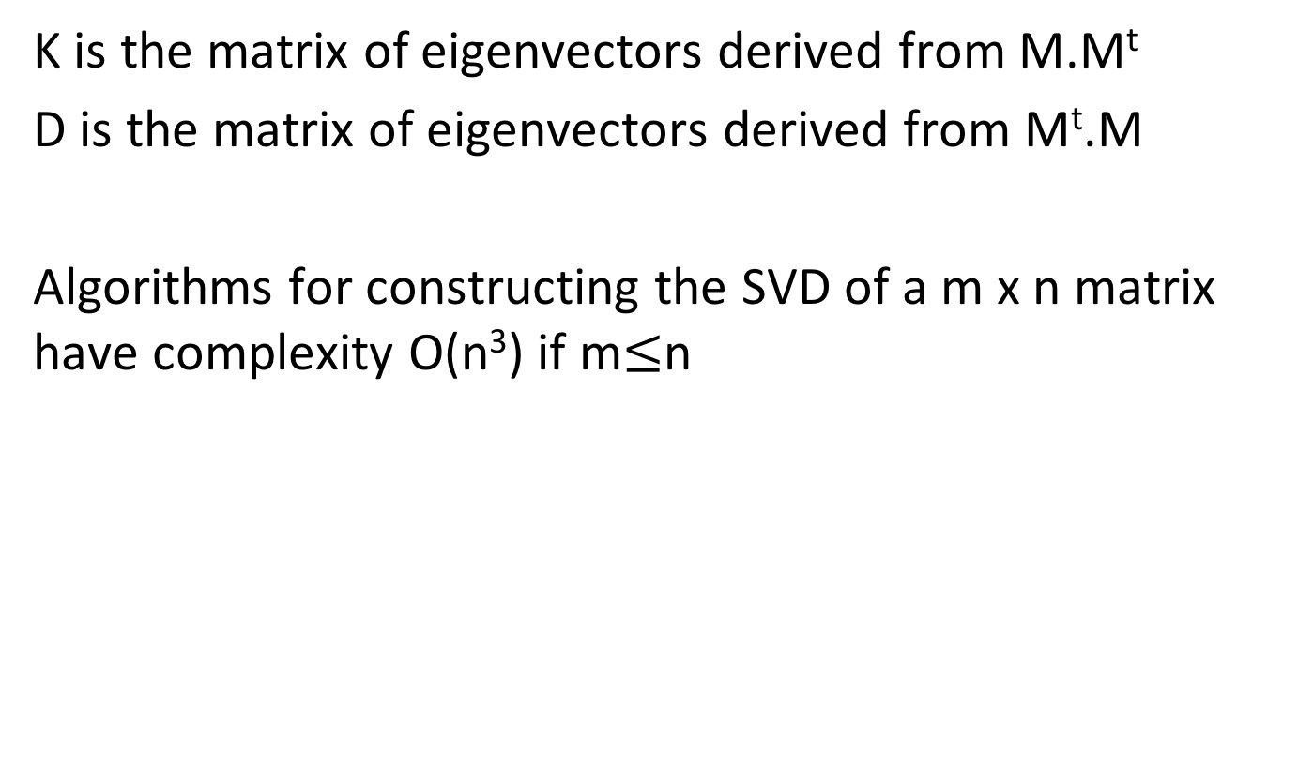
Construction of SVD
K is the matrix of eigenvectors derived from M.M^{t}
D is the matrix of eigenvectors derived from M^{t}.M
Algorithms for constructing the SVD of a m x n matrix have complexity O(n³) if m$≤$n
Notes:
Formally the SVD can be computed by constructing eigenvectors of matrices derived from the original matrix M. This computation can be performed in O(n^3). Note that the complexity is considerable, which makes the approach computationally expensive. There exist however also approximation and randomized techniques to perform this decomposition more efficiently (e.g. https://research.fb.com/blog/2014/09/fast-randomized-svd/)

Slide 16
Interpretation of SVD
We can write M = K.S.D^{t} as sum of outer vector products
The s_{i} are ordered in decreasing size
By taking only the largest ones we obtain a «good» approximation of M (least square approximation)
The singular values s_{i} are the lengths of the semi-axes of the hyperellipsoid E defined by
Each value s_{i} corresponds to a dimension of a "concept space »
Notes:
One way to understand of how the SVD extracts the important concepts from the term-document matrix is the following: the decomposition can be used to rewrite the original matrix as the sum of components that are weighted by the singular values. Thus we can obtain approximations of the matrix by only considering the larger singular values. The SVD after eliminating less important dimensions (smaller singular values) can be interpreted as a least square approximation to the original matrix. The symbol ⊗ denotes the outer product of two vectors, d_{i} is the i-th row of D.
The outer product of vectors u =.(u_1,…,u_m) and v = (v_1,…,v_n) is given by the mxn matrix m with entries m_ij = u_i v_j.
The singular values have also a geometrical interpretation, as they tell us how a unit ball (||x||=1) is distorted when the linear transformation defined by the matrix M is applied to it. We can interpret the axes of the hyperellipsoid E as the dimensions of the concept space.

Slide 17
Illustration of SVD
n
r
r
n
m
M
=
K
•
S
•
D^{t}
r
Vectors represent
documents in concept space
Vectors represent
terms in concept space
m x n
m x r
r x r
r x n
Assuming m ≤ n
Notes:
This figure illustrates the structure of the matrices generated by the SVD. In general, m <= n, i.e., the number of documents may be larger than the size of the vocabulary. The rows in K can then be interpreted as the representation of terms in the concept space, and the rows in D as the representation of documents in the concept space.

Slide 18
Illustration of SVD – Another Perspective
n
r
r
n
m
M
=
K
•
S
•
D^{t}
r
Vectors represent
concepts in document space
Vectors represent
concepts in term space
m x n
m x r
r x r
r x n
Assuming m ≤ n
Notes:
We can also see of how the concepts are represented by terms respectively documents. In particular, each concepts is now described as a weighted vector of terms.

Slide 19
Latent Semantic Indexing (LSI)
In the matrix S, select only the s largest singular values
Keep the corresponding columns in K and D
The resultant matrix is called M_{s} and is given by
M_{s} = K_{s}.S_{s}.D_{s}^{t} where s, s < r, is the dimensionality of the concept space
The parameter s should be
large enough to allow fitting the characteristics of the data
small enough to filter out the non-relevant representational details
Notes:
Using the singular value decomposition, we can now derive an "approximation" of M by taking only the s largest singular values in matrix S. The choice of s determines on how many of the "important concepts" the ranking will be based on. The assumption is that concepts with small singular value in S are rather to be considered as "noise" and thus can be neglected. The resulting method is called Latent Semantic Indexing.

Slide 20
Illustration of Latent Semantic Indexing
n
s
n
m
M_{s}
=
K_{s}
•
S_{s}
•
D_{s}^{t}
s
Document vectors
Term vectors
m x n
m x s
s x s
s x n
Notes:
This figure illustrates the structure of the matrices after reducing the dimensionality of the concept space to s, when only the first s singular values are kept for the computation of the ranking. The rows in matrix K_{s} correspond to term vectors, whereas the columns in matrix D_{s}^{t} correspond to document vectors. By using the cosine similarity measure between columns of matrix D_{s}^{t} the similarity of documents can be computed.

Slide 21
Answering Queries
Documents can be compared by computing cosine similarity in the concept space, i.e., comparing their columns (D_{s}^{t})_{i} and (D_{s}^{t})_{j} in matrix D_{s}^{t}
A query q is treated like one further document
it is added as an additional column to matrix M
the same transformation is applied to this column as for mapping M to D
Notes:
After performing the SVD the similarity of different documents can be determined by computing the cosine similarity measure among their representation in the concept space (the columns of matrix D_{s}^{t}). Queries are considered like documents that are added to the document collection. Answering queries then corresponds then to computing the similarity between the query considered as a document and the documents in the collection.

Slide 22
Mapping Queries
Mapping of M to D
M = K.S.D^{t} S⁻¹.K^{t} .M = D^{t} (since K.K^{t} = 1) D = M^{t} .K.S⁻¹
Apply same transformation to q:
q* = q^{t}.K_{s}.S_{s}⁻¹
Then compare transformed vector by using the standard cosine measure
Notes:
This construction works as follows: when a new column (the query) is added to M, we have to apply the same transformation to this new column, as to the other columns of M, in order to produce the corresponding column in the matrix D_{s}^{t}, representing documents in the concept space. We exploit the fact that K_{s} ^{t}.K_{s} =1.
Since M_{s} = K_{s} .S_{s} .D_{s}^{t} we obtain S_{s} ^{–1} .K_{s} ^{t} .M_{s} = D_{s}^{t} or D_{s}= M_{s} ^{t} .K_{s} .S_{s} ^{–1 .}
This is the transformation that is applied to the query vector q to obtain a query vector q* in the concept space. After that step, the similarity of the query to the documents in the concept space can be computed. ((D_{s}^{t})_{i} denotes the i-th column of matrix D_{s}^{t})

Slide 23
Illustration of LSI Querying
n
s
q^{t}
n
q*
m
M_{s}
=
K_{s}
•
S_{s}
•
D_{s}^{t}
s
Document vectors
Term vectors
m x n
m x s
s x s
s x n
Notes:
This figure illustrates of how a query vector is treated like an additional document vector.

Slide 24
Example: Documents
B1 A Course on Integral Equations
B2 Attractors for Semigroups and Evolution Equations
B3 Automatic Differentiation of Algorithms: Theory, Implementation, and Application
B4 Geometrical Aspects of Partial Differential Equations
B5 Ideals, Varieties, and Algorithms: An Introduction to Computational Algebraic Geometry and Commutative Algebra
B6 Introduction to Hamiltonian Dynamical Systems and the N-Body Problem
B7 Knapsack Problems: Algorithms and Computer Implementations
B8 Methods of Solving Singular Systems of Ordinary Differential Equations
B9 Nonlinear Systems
B10 Ordinary Differential Equations
B11 Oscillation Theory for Neutral Differential Equations with Delay
B12 Oscillation Theory of Delay Differential Equations
B13 Pseudodifferential Operators and Nonlinear Partial Differential Equations
B14 Sinc Methods for Quadrature and Differential Equations
B15 Stability of Stochastic Differential Equations with Respect to Semi-Martingales
B16 The Boundary Integral Approach to Static and Dynamic Contact Problems
B17 The Double Mellin-Barnes Type Integrals and Their Applications to Convolution Theory
Notes:
This is an example of a (simple) document collection that we will use in the following as running example.

Slide 25
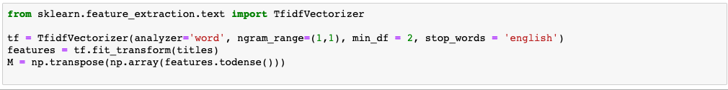
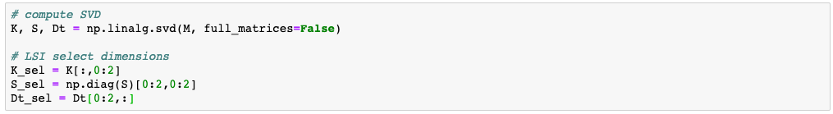
Implementation in Python

Slide 26
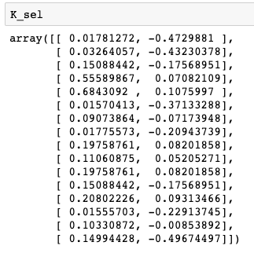
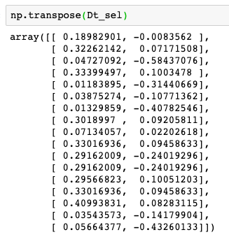
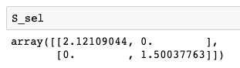
Results (s=2)

Slide 27
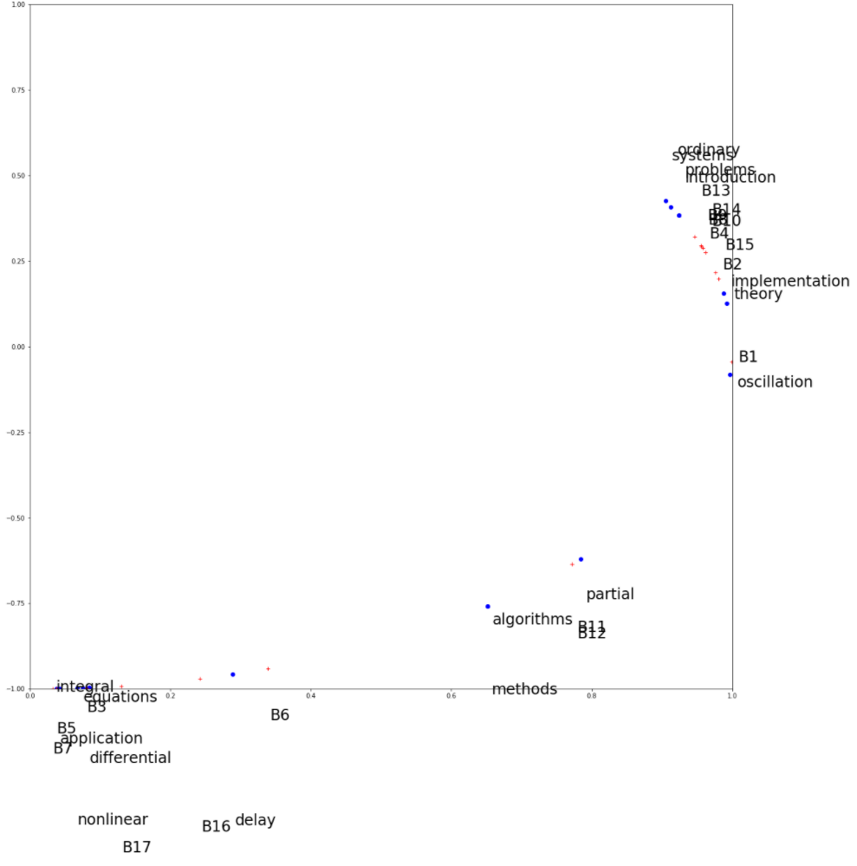
Plot of Terms and Documents in 2-d Concept Space
Notes:
Since in our example the concept space has two dimensions, we can plot both the documents and the terms in this 2-dimensional space. It is interesting to observe of how semantically "close" terms and documents cluster in the same regions. This illustrates very well the power of latent semantic indexing in revealing the « essential concepts » in document collections.

Slide 28
Applying SVD to a term-document matrix M. Each concept is represented in K
as a singular value
as a linear combination of terms of the vocabulary
as a linear combination of documents in the document collection
as a least squares approximation of the matrix M

Slide 29
The number of term vectors in the matrix K_{s} used for LSI
Is smaller than the number of rows in the matrix M
Is the same as the number of rows in the matrix M
Is larger than the number of rows in the matrix M

Slide 30
A query transformed into the concept space for LSI has …
s components (number of singular values)
m components (size of vocabulary)
n components (number of documents)

Slide 31
Discussion of Latent Semantic Indexing
Latent semantic indexing provides an interesting conceptualization of the IR problem
Advantages
It allows reducing the complexity of the underlying concept representation
Facilitates interfacing with the user
Disadvantages
Computationally expensive
Poor statistical explanation
Notes:
From a modelling perspective LSI suffers from poor explanatory power. For example, the least squares approximation concept is related to the assumption that term frequencies are normally distributed, which is in contradiction with the observation that term frequencies are power law distributed.

Slide 32
Alternative Techniques
Probabilistic Latent Semantic Analysis
Based on Bayesian Networks
Latent Dirichlet Allocation
Based on Dirichlet Distribution
State-of-the-art method for concept extraction
Same objective of creating a lower-dimensional concept space based on the term-document matrix
Better explained mathematical foundation
Better experimental results
Notes:
The conceptual problems of LSI have triggered significant efforts in developing better suited models for concept extraction. The most recent and successful result of this has been the development of a method based on the use of Dirichlet distributions. Like LSI it produces a concept space, where concepts are represented as term vectors. The method has better theoretical foundations and empirically it produces better results, and is nowadays considered as the golden standard. The approach is mathematically more involved than LSI, and therefore we will not be able to develop this method in this course.

Slide 33
Latent Dirichlet Allocation (LDA)
Idea: assume a document collection is (randomly) generated from a known set of topics (probabilistic generative model)
money
money
bank
loan
DOCUMENT 1: money¹ bank¹ bank¹ loan¹ river² stream² bank¹ money¹ river² bank¹ money¹ bank¹ loan¹ money¹ stream² bank¹ money¹ bank¹ bank¹ loan¹ river² stream² bank¹ money¹ river² bank¹ money¹ bank¹ loan¹ bank¹ money¹ stream²
.8
loan
bank
bank
Topic is a mixture of words
loan
.2
Document is a mixture of topics
TOPIC 1
.3
river
bank
DOCUMENT 2: river² stream² bank² stream² bank² money¹ loan¹ river² stream² loan¹ bank² river² bank² bank¹ stream² river² loan¹ bank² stream² bank² money¹ loan¹ river² stream² bank² stream² bank² money¹ river² stream² loan¹ bank² river² bank² money¹ bank¹ stream² river² bank² stream² bank² money¹
stream
river
.7
river
bank
stream
TOPIC 2
Notes:
This illustration shows the basic idea underlying LDA: it is assumed that there exist topics that are represented as mixtures of words. In the example we see words that are related to two meanings of “bank”, the financial institution and the river bank, and are represented by different related works. Then, documents are supposed to be generated from a mixture of topics, where the mixture is defined by some weights, as indicated in the figure. As a result each document contains terms form its associated topics in the right proportion.
Similar to the probabilistic language model used in information retrieval, we have here another example of a probabilistic generative model.

Slide 34
Document Generation using a Probabilistic Process
For each document, choose a mixture of topics
For every word position, sample a topic from the topic mixture
For every word position, sample a word from the chosen topic
TOPIC MIXTURE
TOPIC
WORD
TOPIC
WORD
...
...
Notes:
Given the underlying model we can define a probabilistic process for generating documents.

Slide 35
LDA: Topic Identification
Approach: Inverting the process: given a document collection, reconstruct the topic model
?
DOCUMENT 1: money? bank? bank? loan? river? stream? bank? money? river? bank? money? bank? loan? money? stream? bank? money? bank? bank? loan? river? stream? bank? money? river? bank? money? bank? loan? bank? money? stream?
TOPIC 1
?
DOCUMENT 2: river? stream? bank? stream? bank? money? loan? river? stream? loan? bank? river? bank? bank? stream? river? loan? bank? stream? bank? money? loan? river? stream? bank? stream? bank? money? river? stream? loan? bank? river? bank? money? bank? stream? river? bank? stream? bank? money?
?
TOPIC 2
Notes:
The challenge is to determine the probabilistic model. The situation we consider in practice is that a set of documents is given, and we intend to reconstruct the (most likely) probabilistic process that has generated this document collection. This is a difficult problem to solve.

Slide 36
Latent Dirichlet Allocation
Topics are interpretable unlike the arbitrary dimensions of LSI
Distributions follow a Dirichlet distribution
Construction of topic model is mathematically involved, but computationally feasible
Considered as the state-of-the art method for topic identification
Notes:
We do not present the details of LDA here, as the method is mathematically fairly involved. However, it is important to note that it is considered today as the state-of-the-art method of topic detection.

Slide 37
Use of Topic Models
Unsupervised Learning of topics
Understanding main topics of a topic collection
Organizing the document collection
Use for document retrieval: use topic vectors instead of term vectors to represent documents and queries
Document classification (Supervised Learning): use topics as features
Notes:
Topic models provide a representation of documents at a conceptual level. Therefore they are applied in many different contexts, including document retrieval and classification.

Slide 38
Summary
0
1
0
1
0
0
0
0
0
1
0
0
1
0
0
1
0
0
0
0
1
0
1
0
0
0
0
1
0
0
0
0
0
1
1
1
0
0
1
0
1
0
0
0
1
0
0
0
1
0
0
1
1
1
0
1
0
0
0
0
0
1
1
0
0
1
0
0
1
VS model maps documents to
sparse term vectors
Topic model maps documents to
dense vectors (dimension = topic)
Each topic corresponds to a distribution over terms
Notes:
This illustration summarizes the connection among the vector space model, which was introduced for information retrieval and topic models that produce low-dimensional (dense) representation of documents.

Slide 39
10. Word Embeddings

Slide 40
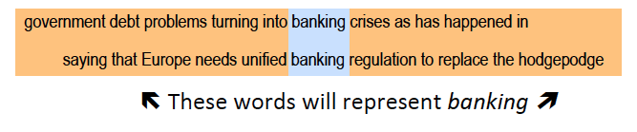
Word Context
The neighborhood of a word expresses a lot about its meaning
“You shall know a word by the company it keeps” (J. R. Firth 1957)
Notes:
With latent semantic indexing we have exploited the idea that words that occur together in documents have a likelihood to have also some shared meaning. This idea is actually quite old, and has been already expressed, for example, by Firth in 1957. We will now exploit this idea in a slightly different way, by focusing on a much smaller context of a word than its document. We will just consider the local neighborhood of the work within a phrase. Typically we will consider all the neighborhoods that we can find in all documents of a large document collection.

Slide 41
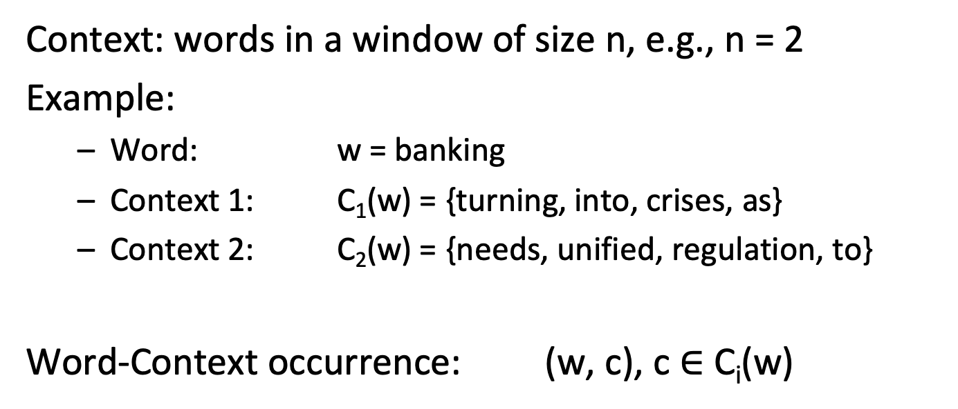
Word Context
Context: words in a window of size n, e.g., n = 2
Example:
Word: w = banking
Context 1: C₁(w) = {turning, into, crises, as}
Context 2: C₂(w) = {needs, unified, regulation, to}
Word-Context occurrence: (w, c), c $∈$C_{i}(w)
Notes:
For each word w we can identify its neighboring words, which will call its context and denote by C(W). The context can be determined by choosing a certain number of preceding and succeeding words, e.g. a typical number used is 5.

Slide 42
Similarity-Based Representation
One of the most successful ideas in natural language processing
Two words are considered as similar, when they have similar contexts
Context captures both syntactic and semantic similarity
Syntactic: e.g. king – kings
Semantic: e.g. king – queen
Implicitly used with the term-document matrix M
Less localized context
No distinction between roles of context and word
Notes:
This idea is one of the main ideas used (successfully) in natural language processing. The neighborhood captures not only semantic relationships among words (as would also co-occurrence in the same document).It can at the same time also capture syntactic relationships. This is a main difference to methods based on document co-occurrence like LSI.
A second important difference is that methods based on this idea distinguish between a word occurring as the center of a context and as a member of context. For example, it is very unlikely the word “dog” would have in its context a second occurrence of the word “dog”. Thus dog as a “context word” needs to be treated differently from dog as the word of interest. This distinction is not made in purely co-occurrence based methods.

Slide 43
Idea: Word Embeddings
Model how likely a word and a context occur together
Approach:
Map words into a low-dimensional space (e.g., d = 200)
Map context words into the same low-dimensional space
A different mapping for the same words
Interpret the vector distance (product) as a measure for how likely the word and its context occur together
Due to projection in low-dimensional space, similar words and contexts should be close
Notes:
The basic idea for word embeddings is simple. Both words and context words are mapped into the same low-dimensional space. Their representations in that space should be similar, if the word and the context word occur often together. Thus we capture the information on word context in a low-dimensional representation. Through the dimensionality reduction the expectation is that words and contexts that play similar roles would also move together, and thus we could capture syntactic and semantic similarity.
Dimensionality reduction is helpful, since vocabularies can become very large, in particular if not only words but also short phrases are included (e.g. tens of millions of entries). Thus data would be very sparse in these spaces and it would be difficult to model similarity. The low-dimensional spaces have on the other hand typically a few hundred dimensions.

Slide 44
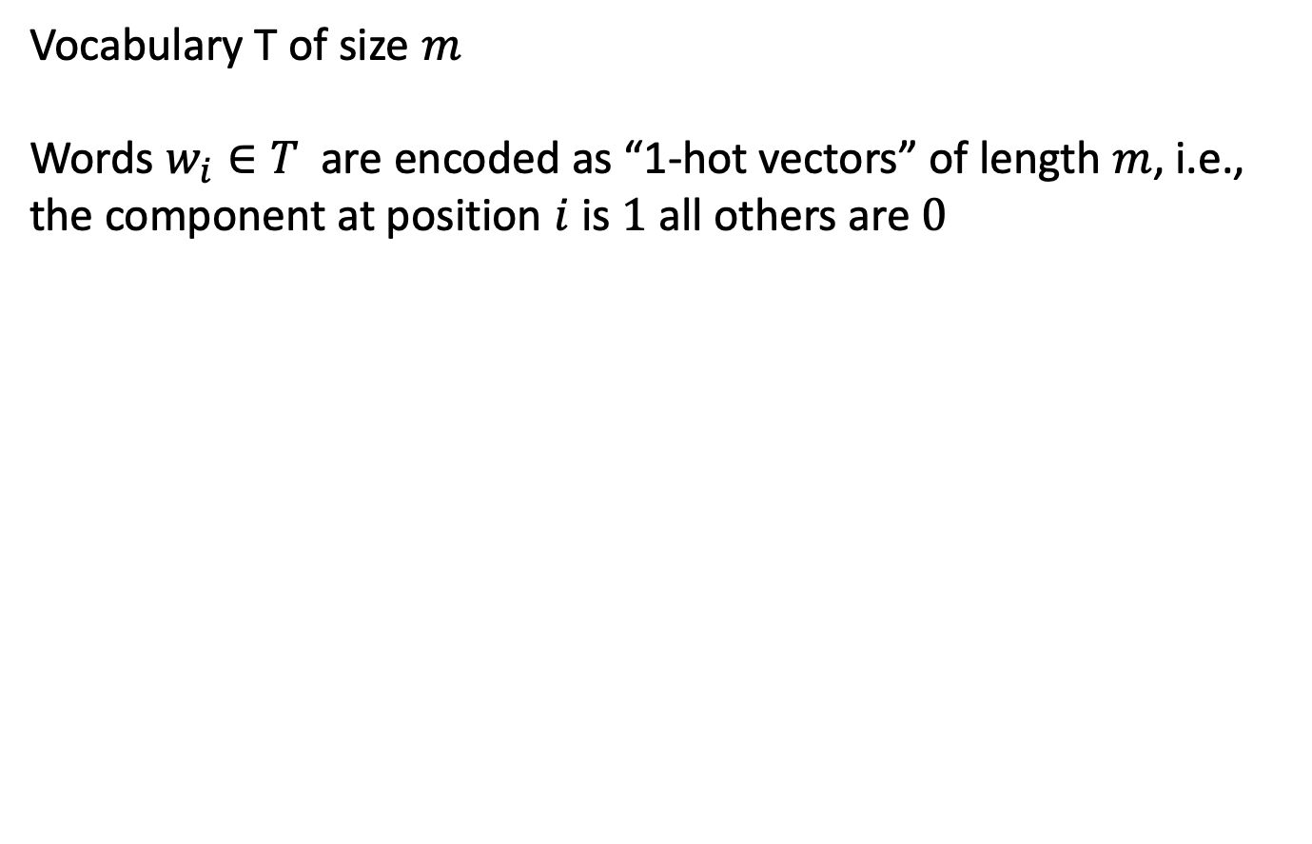
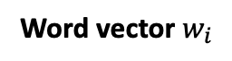
Mapping to Concept Space
Vocabulary T of size $m$
Words $w_{i}∈T$ are encoded as “1-hot vectors” of length $m$, i.e., the component at position $i$ is $1$ all others are $0$
Word vector $w_{i}$
0
0
.
.
1
.
.
0
0
0
0
Position i
Notes:
We introduce now the representations of words and context words in an m-dimensional space. The representation where the i-th component of a vector is set to 1 for the i-th word in the vocabulary is called often the 1-hot encoding.

Slide 45
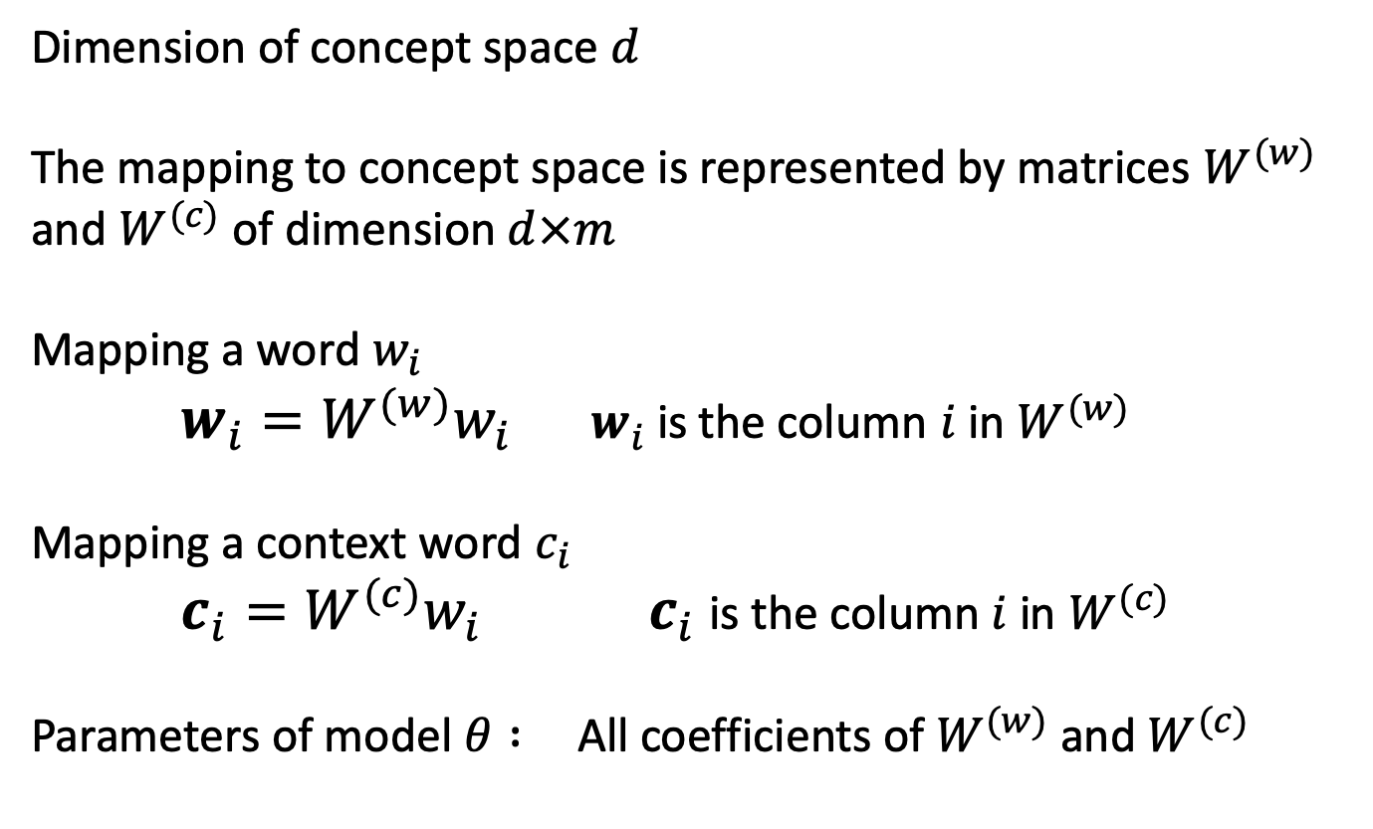
Model Parameters
Dimension of concept space $d$
The mapping to concept space is represented by matrices $W^{(w)}$ and $W^{(c)}$ of dimension $d×m$
Mapping a word $w_{i}$
$w_{i}=W^{(w)}w_{i} { w}_{i}$is the column $i$ in $W^{(w)}$
Mapping a context word $c_{i}$
$c_{i}=W^{(c)}w_{i} { c}_{i}$is the column $i$ in $W^{(c)}$
Parameters of model $θ :$All coefficients of $W^{(w)}$ and $W^{(c)}$
Notes:
We introduce now the parameters of the word embedding model. First, we choose the dimension of concept space. Note that the size of the vocabulary m is typically very large (e.g. millions), whereas the size of the low-dimensional space d is typically in the hundreds.
The model is specified by the two matrices W^{(w)} and W^{(c)} used to map words and context words into the concept space. Note that the two mappings are different, i.e. the same word will have a different representation in its role as word and context word.
For convenience we will denote in the following the coefficients of these two matrices by $θ$.

Slide 46
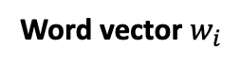
Illustration
m
Word vector $w_{i}$
0
0
.
.
1
.
.
0
0
0
0
Position i
d
W^{(w)}
•
m
d x m
Columns represent words of the vocabulary in concept space
Notes:
Here we illustrate the mapping of words into concept space. Since the word vectors use the 1-hot encoding, we observe that the columns of the matrix W^{(w)} in fact are exactly the representation of the words in the concept space. Similarly, we can also view the mapping of context words.

Slide 47
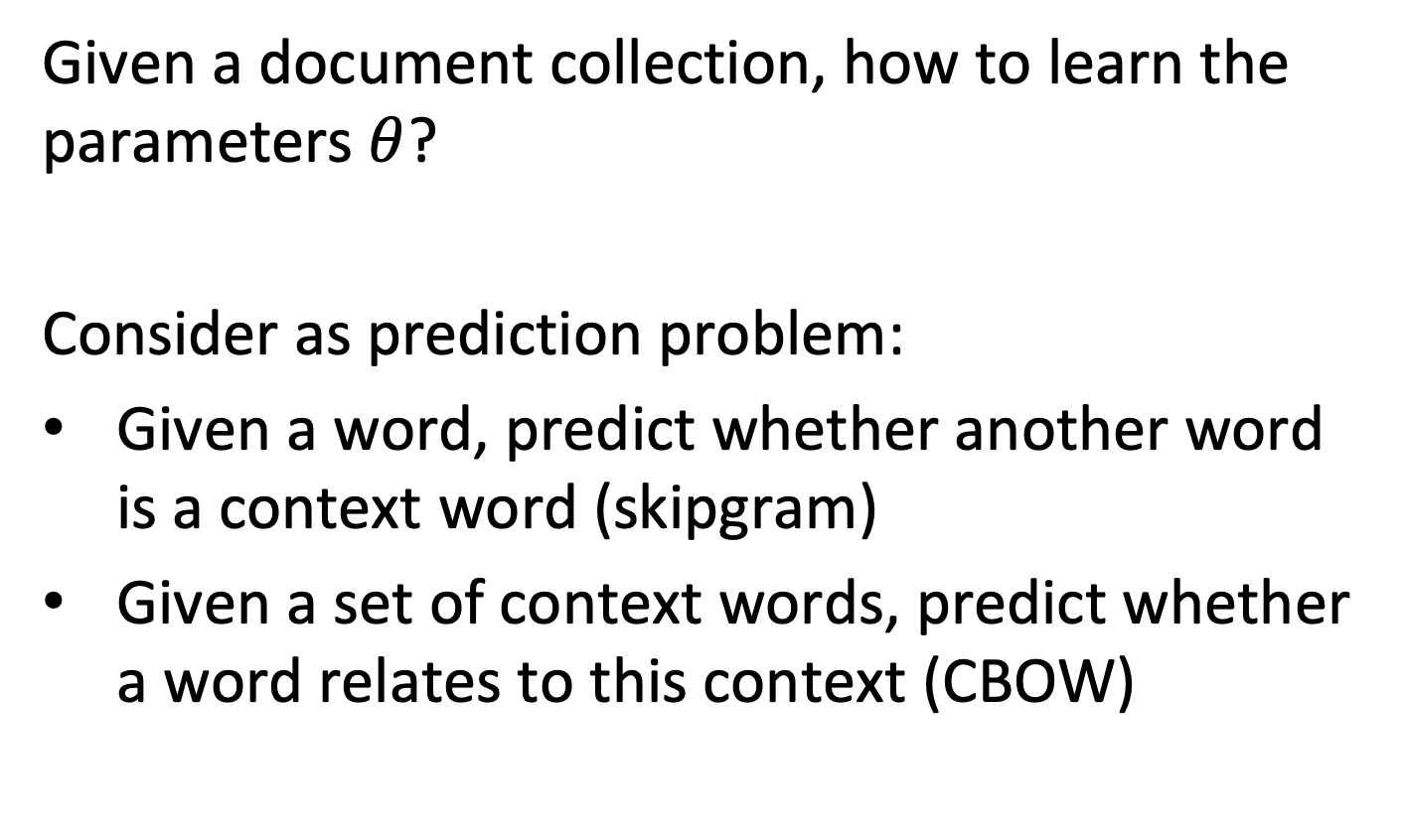
Learning the Model from Data
Given a document collection, how to learn the parameters $θ$?
Consider as prediction problem:
Given a word, predict whether another word is a context word (skipgram)
Given a set of context words, predict whether a word relates to this context (CBOW)
Notes:
The problem we face now, is how to determine the model parameters, given a document collection. To do that we have to formulate a problem that can be solved using an optimization approach.
Since we are interested in the relation between words and context words, we can formulate a prediction problem. The model that we develop should be able to predict for a given word, which are the most likely context word (resulting in what we will be calling the skipgram model), or conversely, given a set of context words, what are the most likely words.

Slide 48
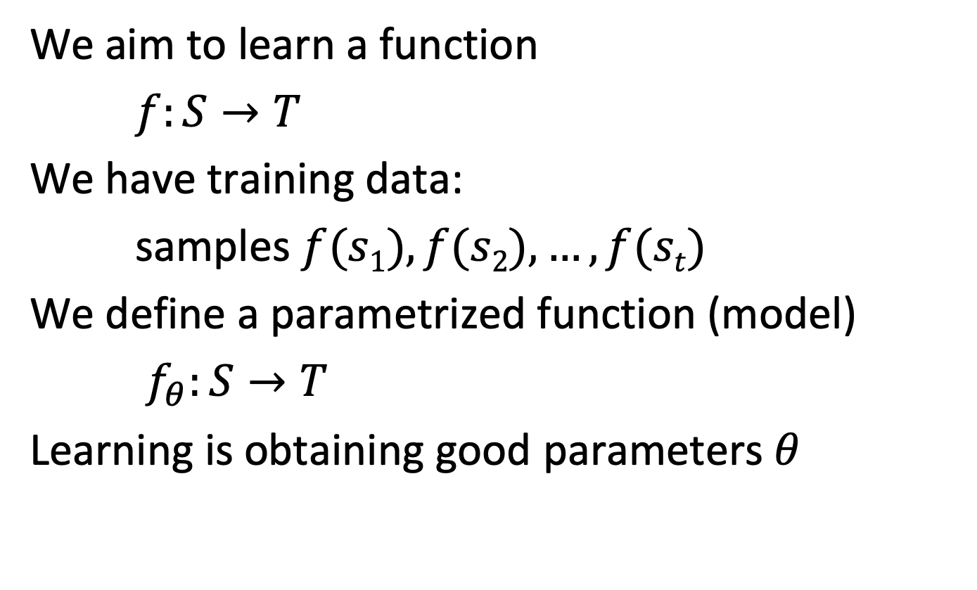
Statistical Learning
We aim to learn a function
$f:S→T$
We have training data:
samples $f(s1), f(s2), …, f(st)$
We define a parametrized function (model)
$f_{θ}:S→T$
Learning is obtaining good parameters $θ$
Notes:
The prediction problem we have formulated corresponds to learning a function $f$.
We can learn an approximation $f_{θ}$ of this function from the samples that we can obtain from the existing document collection.
For our problem this function will be the likelihood that a given word occurs together with some context words, or vice versa.

Slide 49
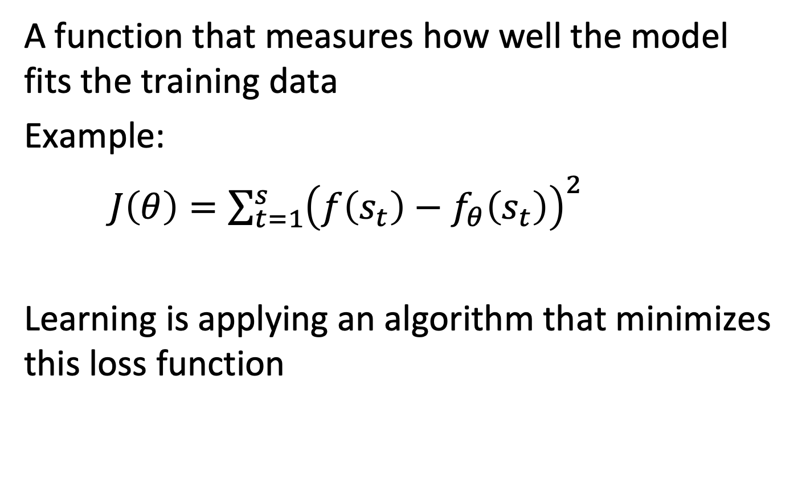
Loss Function
A function that measures how well the model fits the training data
Example:
$J\left(θ\right)=\sum_{t=1}^{s}{{\left(f\left(s_{t}\right)−f_{θ}\left(s_{t}\right)\right)}^{2}}$
Learning is applying an algorithm that minimizes this loss function
Notes:
In order to determine whether a function $f_{θ}$ approximates well the function from the training data, a loss function is introduced. It measures of how much the approximation function is deviating from the function applied to the training data.

Slide 50
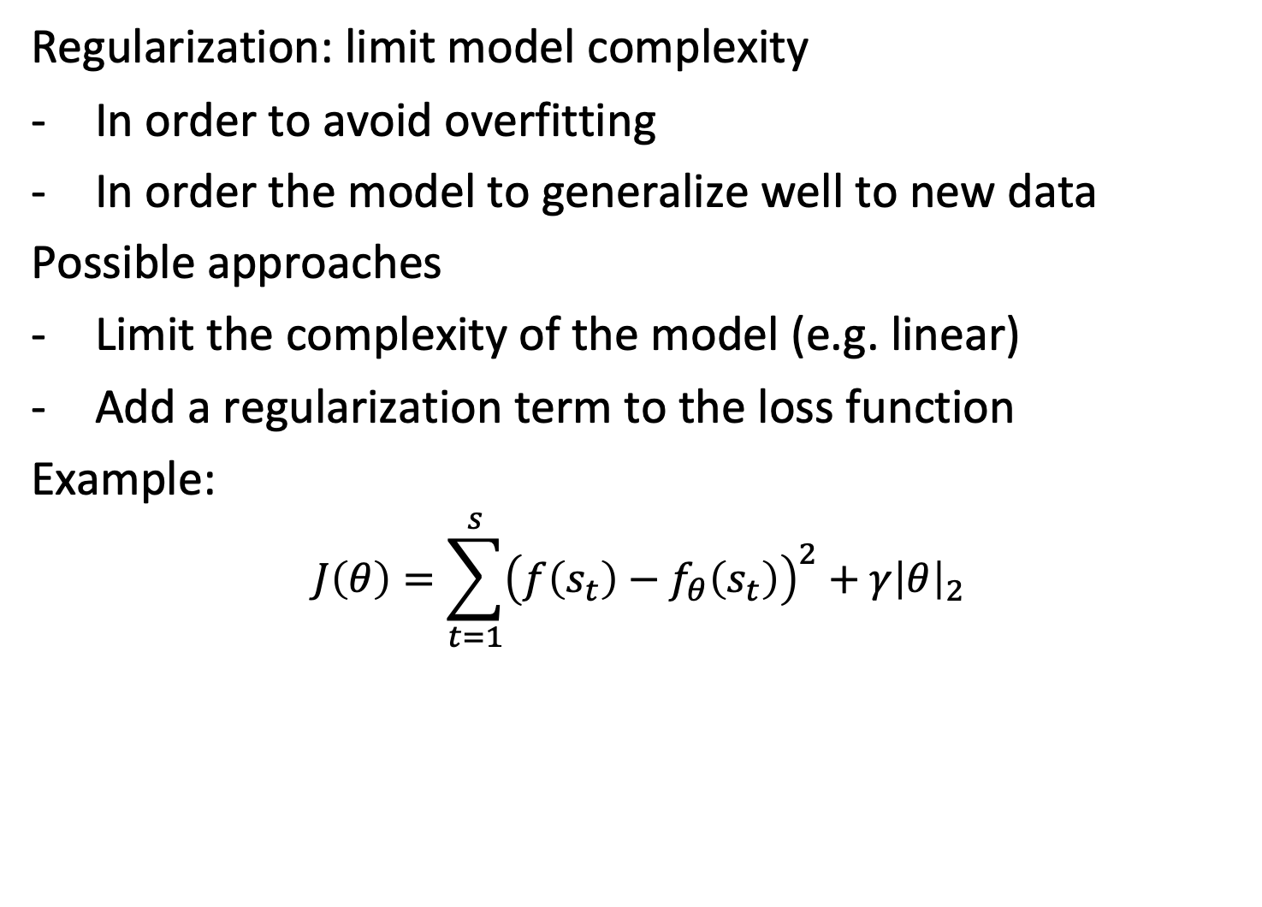
Regularization
Regularization: limit model complexity
In order to avoid overfitting
In order the model to generalize well to new data
Possible approaches
Limit the complexity of the model (e.g. linear)
Add a regularization term to the loss function
Example:
$$J\left(θ\right)=\sum_{t=1}^{s}{{\left(f\left(s_{t}\right)−f_{θ}\left(s_{t}\right)\right)}^{2}}+γ{\left|θ\right|}_{2}$$
Notes:
One key problem in statistical learning (or machine learning) is overfitting. If we provide a large number of parameters $θ$ we can easily learn a good, or even perfect approximation of the function applied to the training data, but the function will perform poorly on other data. Therefore the idea is to “limit” the amount of information that can be stored in the model parameters, by minimizing some measure on them by including it into the loss function. This is called regularization.

Slide 51
Representation Learning
A learning algorithm that creates for some input data a new representation with desirable properties:
Most often the representation is in some vector space
For example, represent words of a vocabulary as vectors
Idea: create the word embeddings using representation learning
Notes:
In general, a statistical learning algorithm can learn any kind of function, like predicting the co-occurrence of words and context-words, or predicting fraud in bank transactions, evolution of stock markets etc. while the parameters of the model$θ$are considered as “hidden parameters” without further use.
In representation learning, the model parameters are associated with some input data, and used to create an alternative representation for it. So no more the prediction itself is the main objective of learning, but obtaining an alternative representation of the training data. The prediction is introduced to formulate an optimization problem of which the solution will generate this representation.

Slide 52
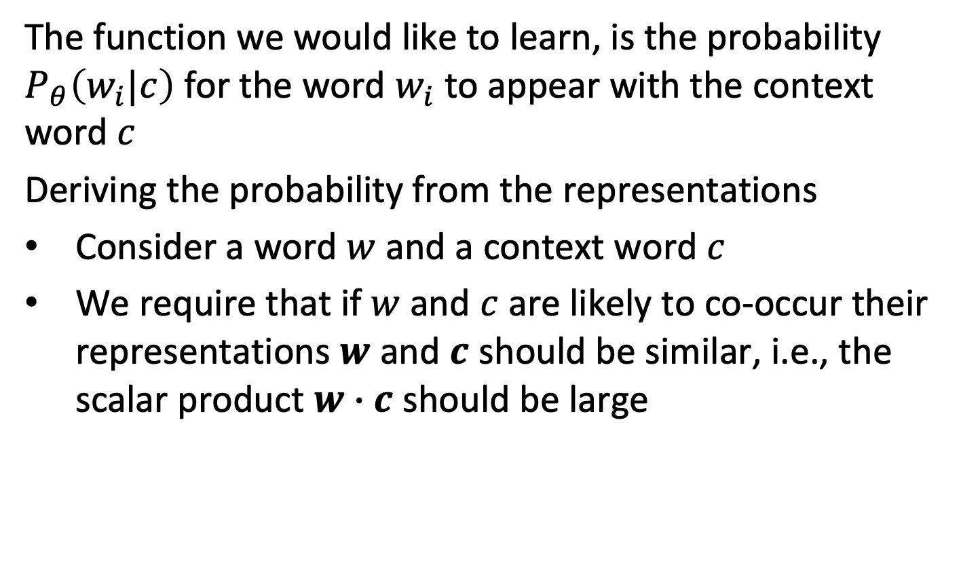
Learning Probabilities
The function we would like to learn, is the probability $P_{θ}\left(w_{i}|c\right)$ for the word $w_{i}$ to appear with the context word $c$
Deriving the probability from the representations
Consider a word $w$and a context word $c$
We require that if $w$ and $c$ are likely to co-occur their representations $w$ and $c$ should be similar, i.e., the scalar product $w∙c$ should be large
Notes:
For learning representations we formulate a learning problem that requires to optimize a function to be learnt. For our purposes we require to learn the probability of words and context words to co-occur. The question is of how to derive such a probability from the model parameters $θ$, i.e. the vector representations of the words.
One consideration we can make is the following: if the words and context words have large probability of co-occurring we can require that their representations are similar, that means their cosine similarity is large. Then we could use this value to determine the probability, which also should be large, from cosine similarity.

Slide 53
Illustration
Banking (word)
Crisis (context word)
Debt (context word)
Banking • Crisis = + 100
Banking • Debt= + 80
Banking • Monkey = -150
Monkey (context word)
Notes:
Here we illustrate the embedding of words and context words in the same low-dimensional space. The idea is that the context words that typically co-occur together with a word, have similar embedding vectors, whereas others (like monkey, which is rarely occurring together with bank) have very different ones. The sigmoid function then converts the similarity values obtained from the scalar products of the embedding vectors into the interval [0,1].

Slide 54
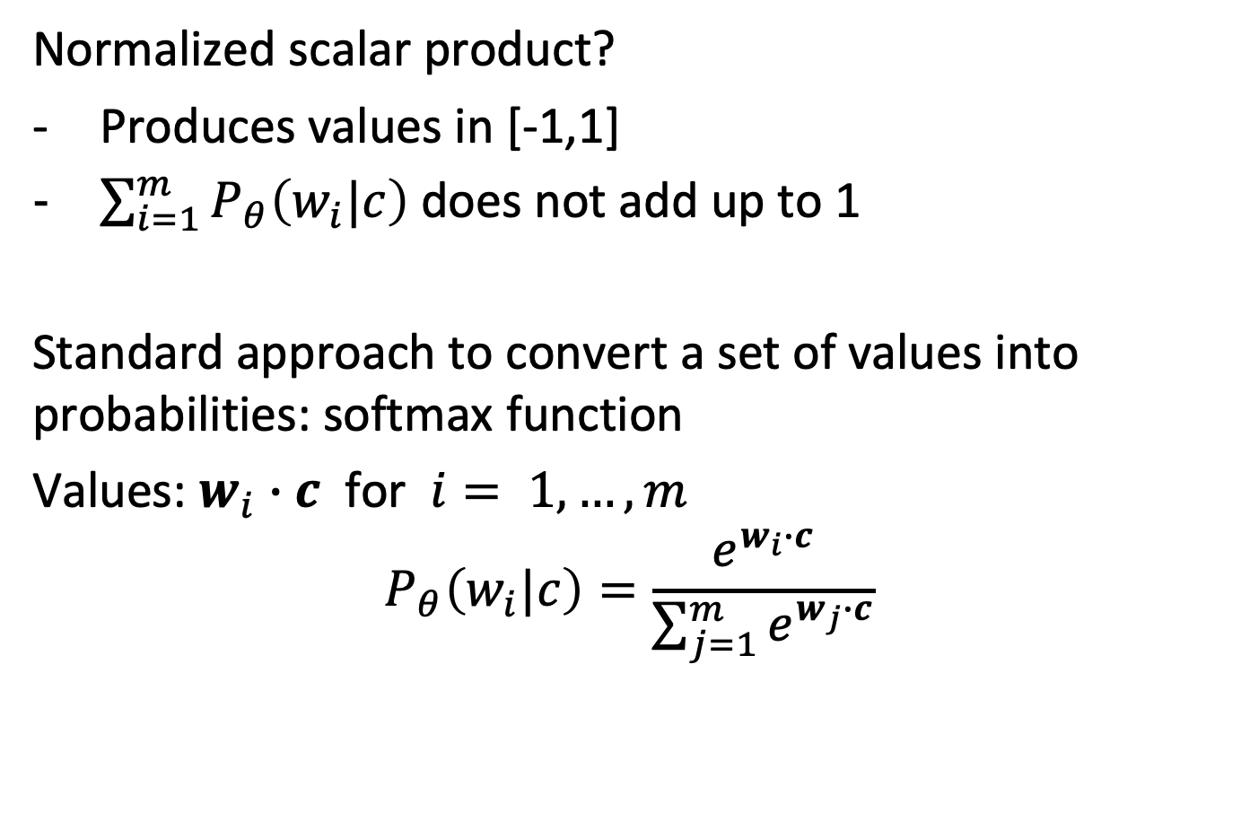
Softmax Function
Normalized scalar product?
Produces values in [-1,1]
$\sum_{i=1}^{m}{P_{θ}\left(w_{i}|c\right)}$ does not add up to 1
Standard approach to convert a set of values into probabilities: softmax function
Values: $w_{i}∙c$ for $i= 1,…,m$
$$P_{θ}\left(w_{i}|c\right)=\frac{e^{w_{i}∙c}}{\sum_{j=1}^{m}{e^{w_{j}∙c}}}$$
Notes:
The problem is of how to derive from the scalar product a probability. If we use the normalized scalar product the issue is that it does neither produce values in the interval [0,1] that could be interpreted as probability values, nor do probabilities add up to 1. E.g. the probability of a given context word to occur together with some word of the vocabulary should add up to 1.
To address this issue, there exists a standard approach to convert an (arbitrary) set of values into a probability distribution. First, applying the exponential function to the set of values (in our case the scalar products), produces positive values only, and second normalizing by the some of the exponentials makes sure that the values fall into the interval [0,1].

Slide 55
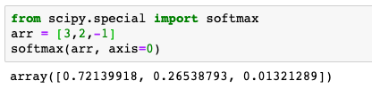
Illustration
Banking (word)
Crisis (context word)
Debt (context word)
Banking • Crisis = +3
Banking • Debt= +2
Banking • Monkey = -1
P(Banking, Crisis) = 0.72
P(Banking, Debt= 0.27
P(Banking, Monkey) = 0.01
Monkey (context word)
Word vectors that are similar, produce values close to 1
Notes:
Applying the softmax function to the scalar products, produces now a probability distribution for a context word, co-occurring with some word of the vocabulary.

Slide 56
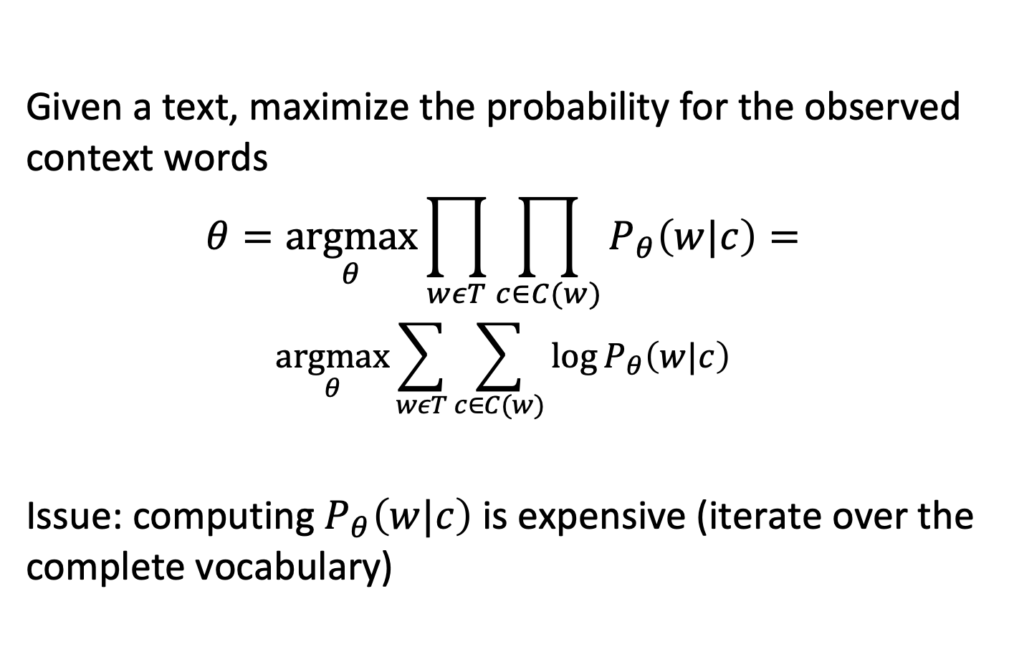
Loss Function for the Model
Given a text, maximize the probability for the observed context words
$$θ=\underset{θ}{argmax}{\prod_{wεT}{\prod_{c∈C(w)}{P_{θ}\left(w|c\right)}}}=$$
$$\underset{θ}{argmax}\sum_{wεT}{\sum_{c∈C(w)}{\log{P_{θ}\left(w|c\right)}}}$$
Issue: computing $P_{θ}\left(w|c\right)$ is expensive (iterate over the complete vocabulary)
Notes:
Based on these considerations we can now formulate a loss function that enables us to learn representations for the words and context words. The loss function aims to optimize the model parameters such that the product of the probability of all word-context word co-occurrences in the training data is maximized. A standard step to reformulate the optimization problem is to apply a logarithm to the loss function, which does not change the maximization problem, but converts the produt into a sum, which is more stable from the perspective of numerical processing.
This gives a first formulation of what is called usually the skipgram Model. One issue with the loss function is that it is expensive to compute, since for each word we have to iterate over the complete vocabulary to compute the probabilities.

Slide 57
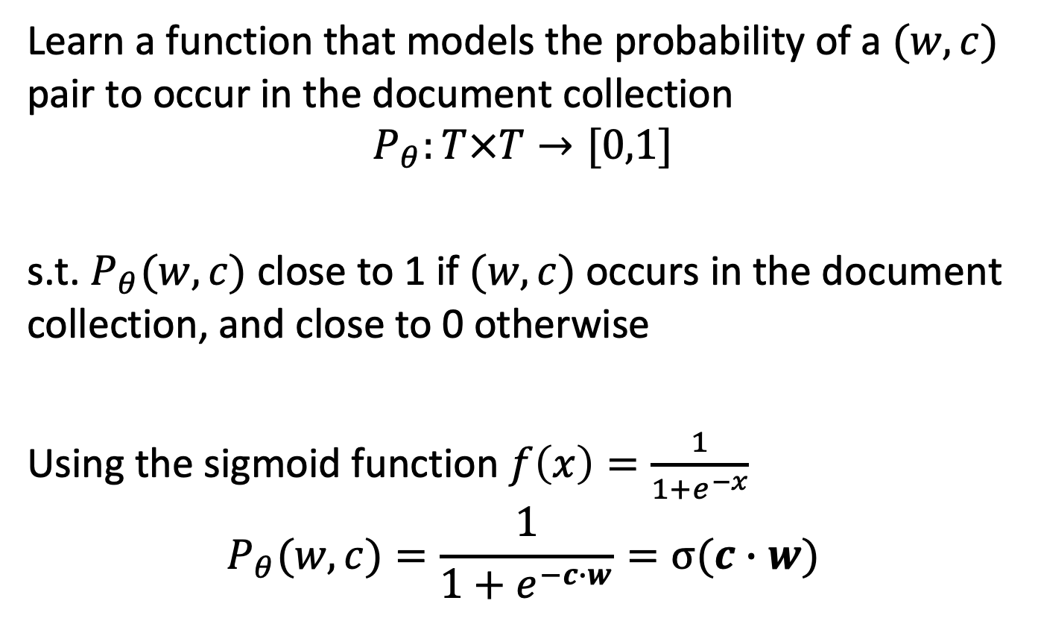
Approximation
Learn a function that models the probability of a $(w,c)$ pair to occur in the document collection
$$P_{θ}:T×T→[0,1]$$
s.t. $P_{θ}(w,c)$ close to 1 if $(w,c)$ occurs in the document collection, and close to 0 otherwise
Using the sigmoid function $f\left(x\right)=\frac{1}{1+e^{−x}}$
$$P_{θ}(w,c)=\frac{1}{1+e^{−c∙w}}=σ(c∙w)$$
Notes:
In order to arrive at a more efficient way to compute the representations, a simpler function can be learnt, which models directly the probability of a word and context word to co-occur, instead of introducing the probability distributions for all context words to co-occur with a specific word. This probability can be derived from the scalar products by applying the sigmoid function, which can be considered as the simpler version of the softmax functions when only a single data value is considered.
Performing this approximation avoids to iterate over the complete vocabulary for each word to compute the conditional probabilities, but rather consider some selected pairs.
Doing this approximation essentially introduces independence assumptions on the occurrences of word-context word pairs. It also changes the problem from a prediction problem (which the words that appear in a context) to a classification problem (which word, context pairs to occur)

Slide 58
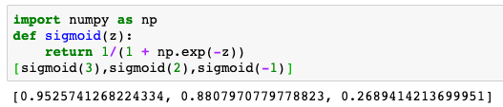
Illustration
Banking (word)
Crisis (context word)
Debt (context word)
Banking • Crisis = +3
Banking • Debt= +2
Banking • Monkey = -1
P(Banking, Crisis) = 0.95
P(Banking, Debt= 0.88
P(Banking, Monkey) = 0.27
Monkey (context word)
Notes:
Here we illustrate the embedding of words and context words using the simpler version of the model. Now the probabilities can be independently computed for word-context word pair. Comparing to the previous example, where we used the softmax function, we see that the order of probability values did not change, but the absolute values are different.

Slide 59
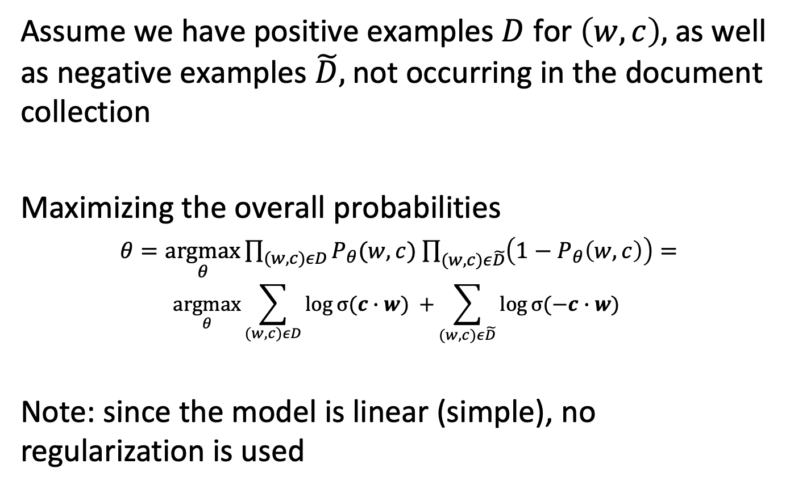
Optimizing the Parameters
Assume we have positive examples $D$ for $\left(w,c\right),$as well as negative examples $\tilde{D},$not occurring in the document collection
Maximizing the overall probabilities
$θ=\underset{θ}{argmax}{\prod_{(w,c)εD}{P_{θ}(w,c)}}$ $\prod_{(w,c)ε\tilde{D}}{\left(1−P_{θ}\left(w,c\right)\right)=}$
$$\underset{θ}{argmax}\sum_{(w,c)εD}{\log{σ(c∙w) }+}\sum_{(w,c)ε\tilde{D}}{\log{σ(−c∙w) }}$$
Note: since the model is linear (simple), no regularization is used
Notes:
Since the problem is now formulated as classification problem, it is necessary to consider also negative examples, i.e. word-context pairs that do not occur in the document collection. Assuming we have such negative examples, we can reformulate the overall optimization problem to obtain the model parameters.

Slide 60
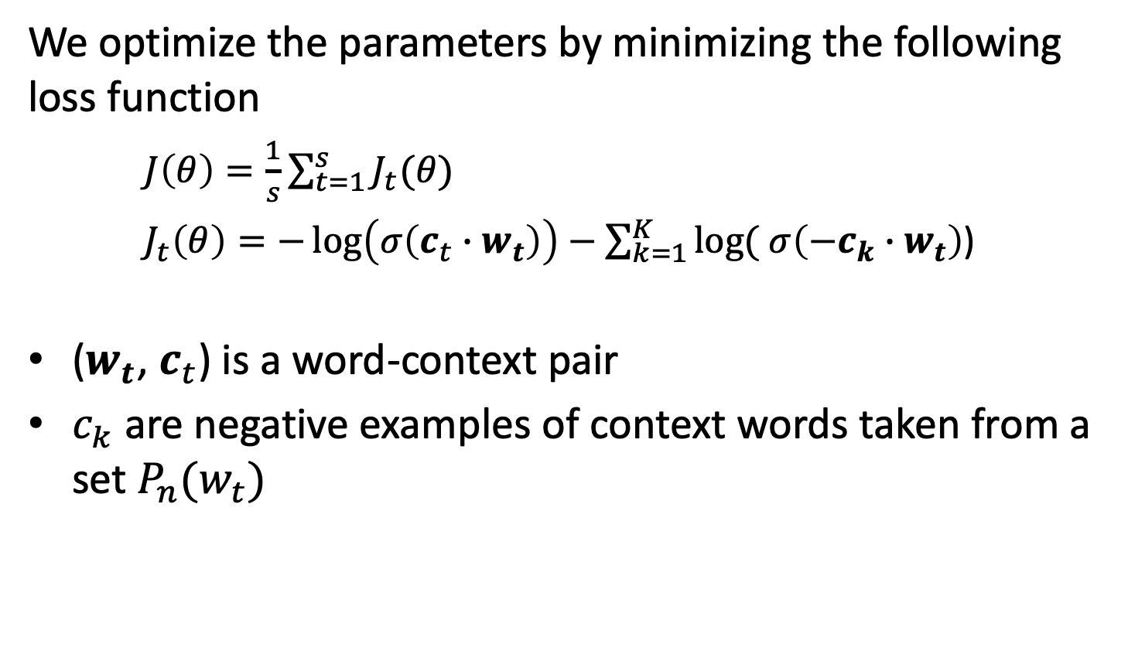
Loss Function
We optimize the parameters by minimizing the following loss function
$J\left(θ\right)=\frac{1}{s}\sum_{t=1}^{s}{J_{t}(θ)}$
$J_{t}\left(θ\right)=−\log\left(σ\left(c_{t}∙w_{t}\right)\right)−\sum_{k=1}^{K}{log⁡(}$ $σ\left(−c_{k}∙w_{t}\right)$)
($w_{t}$, $c_{t}$) is a word-context pair
$c_{k}$ are negative examples of context words taken from a set $P_{n}(w_{t})$
Notes:
Following the previous derivation we can define a loss function J that optimizes the probabilities if minimized. We transform the maximization problem into a minimization problem by defining a loss function $J\left(θ\right)$). The loss function iterates over all word-context pairs in the document collection. For each term w it consists of a first component corresponding to a positive example,the specific (w,c) pair that occurs in the document collection, and a couple of negative examples for the same word. Note that for simplicity of notation we are omitting an index t for the words $c_{k}$
An open question remains of how to obtain the negative examples.

Slide 61
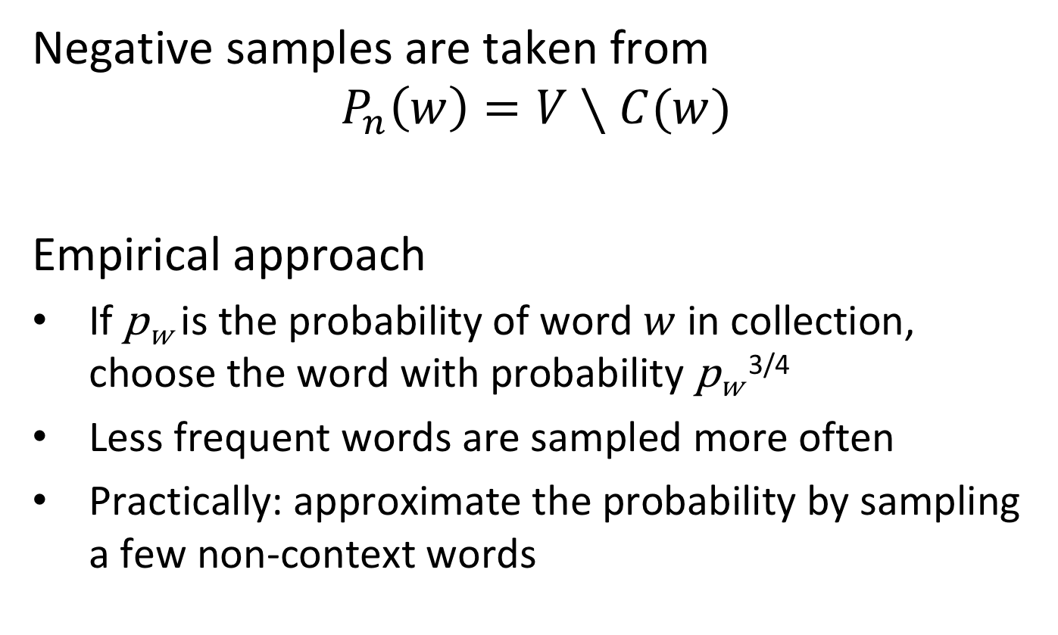
Obtaining Negative Samples
Negative samples are taken from
$$P_{n}\left(w\right)=V∖C(w)$$
Empirical approach
If p_{w} is the probability of word $w$ in collection, choose the word with probability p_{w} ^{3/4}
Less frequent words are sampled more often
Practically: approximate the probability by sampling a few non-context words
Notes:
The method for learning the model relies on having negative samples. How to obtain them? We can choose any word from the vocabulary V that is not contained itself in the context. In order to model the occurrences we do this by considering the frequency at which the words occur in the document collection. Doing so, experience shows that high frequency words (e.g. stopwords) would however be favored to much, reducing the quality of the model. Thus the probability of word occurrence used for sampling is moderated by an exponent (in practice ¾). Also for obtaining the statistics on word probabilities for practical purposes not the whole data collection is used, but just a small sample of words not occurring in the context.

Slide 62
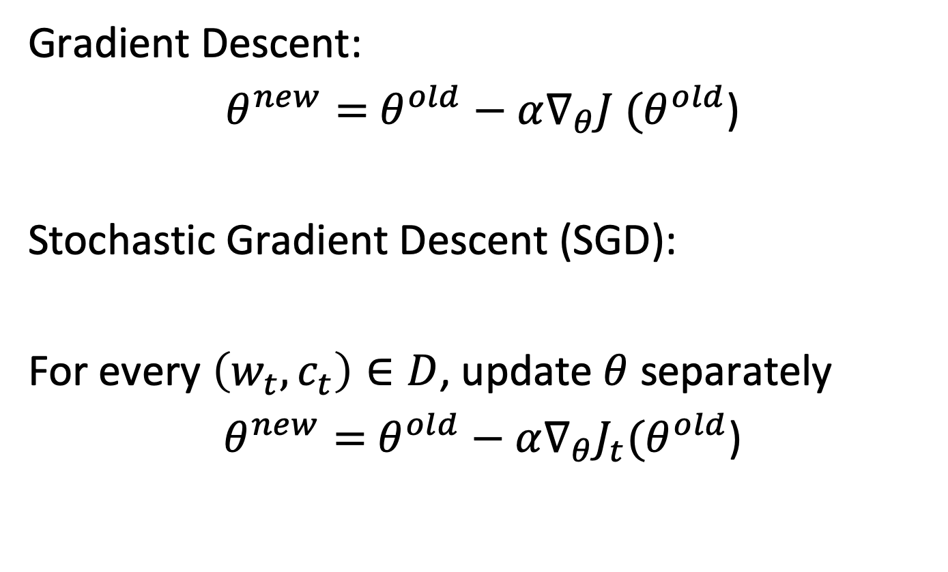
Solving the learning problem
Gradient Descent:
$θ^{new}=$ $θ^{old}−α∇_{θ}J (θ^{old}$)
Stochastic Gradient Descent (SGD):
For every $\left(w_{t},c_{t}\right)∈D$, update $θ$ separately
$θ^{new}=$ $θ^{old}−α∇_{θ}J_{t}(θ^{old}$)
Notes:
Finally, given the loss function, finding the optimal parameters $θ$ can then be done using standard methods from machine learning. $θ$ can be determined using gradient descent, i.e. standard search for minima of a function using derivatives.
To make the problem computationally tractable, we apply stochastic gradient descent. We update the parameters for each sample of a word-context pair, separately. That implies that we have to consider only the corresponding component of the loss function.

Slide 63
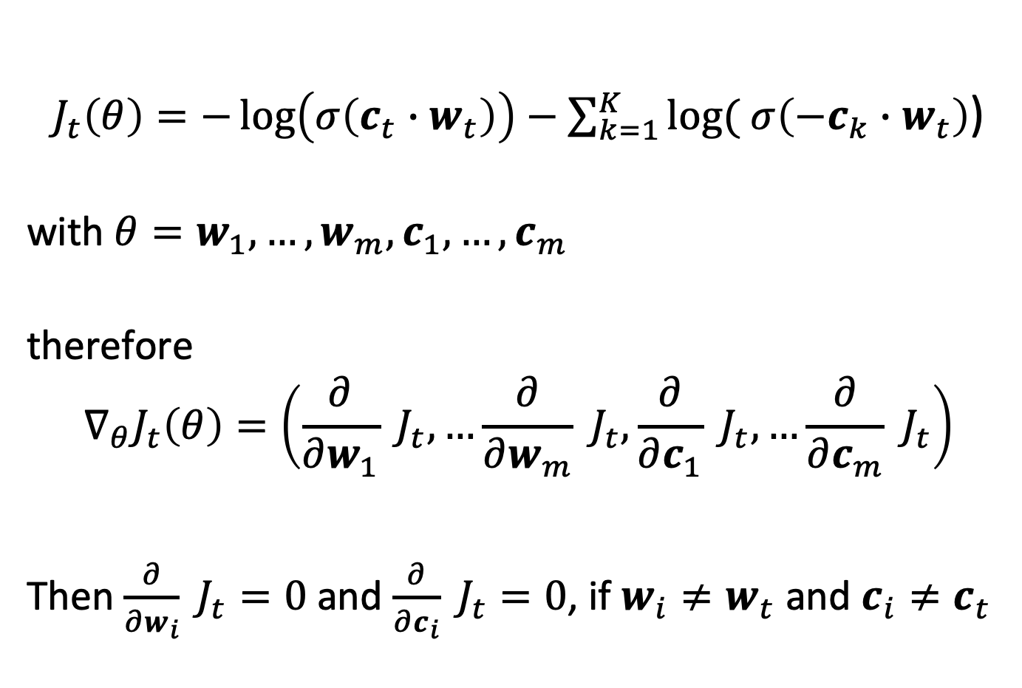
Computing derivatives
$J_{t}\left(θ\right)=−\log\left(σ\left(c_{t}∙w_{t}\right)\right)−\sum_{k=1}^{K}{log⁡(}$ $σ\left(−c_{k}∙w_{t}\right)$)
with $θ=w_{1},…,w_{m},c_{1},…,c_{m}$
therefore
$$∇_{θ}J_{t}\left(θ\right)=\left(\frac{∂}{∂w_{1}} J_{t},…\frac{∂}{∂w_{m}} J_{t},\frac{∂}{∂c_{1}} J_{t},…\frac{∂}{∂c_{m}} J_{t}\right)$$
Then $\frac{∂}{∂w_{i}} J_{t}=0$ and $\frac{∂}{∂c_{i}} J_{t}=0$, if $w_{i}≠w_{t}$ and $c_{i}≠c_{t}$
Notes:
When stochastic gradient descent is used, only rows that contain the word or some context word in the loss function need to be updated. This implies that the data has to be organized that these rows can be efficiently accessed (e.g. using hashing).

Slide 64
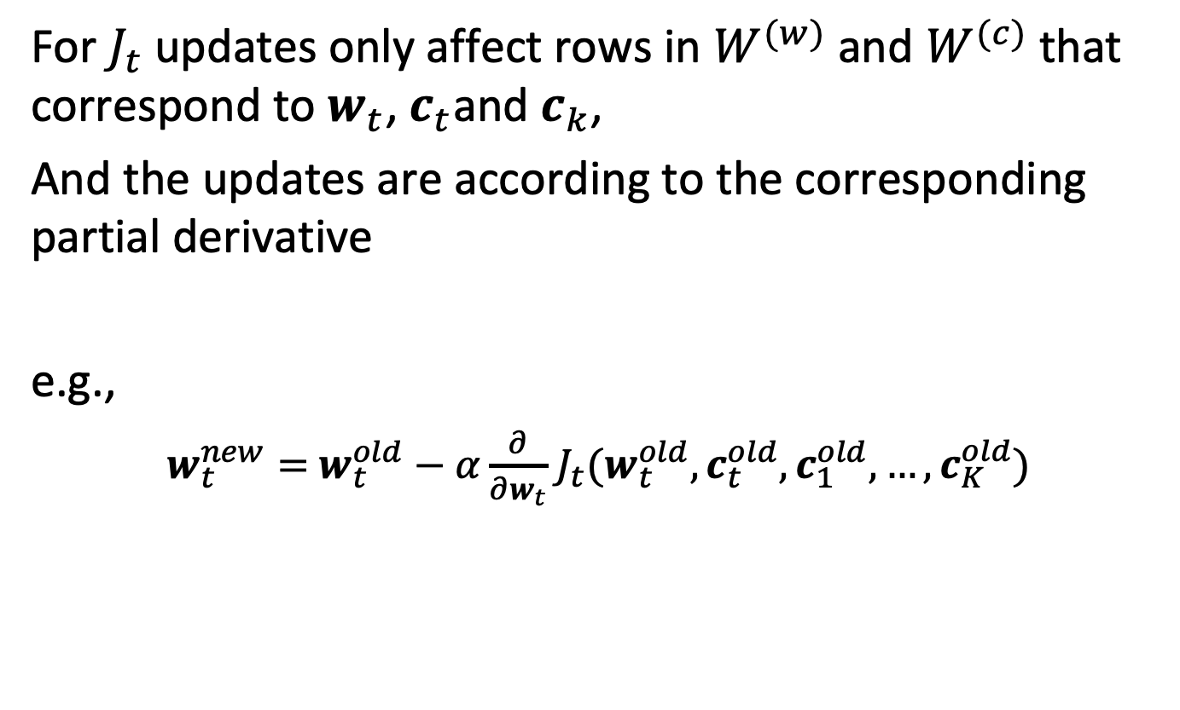
Updating model parameters
For $J_{t}$ updates only affect rows in $W^{(w)}$ and $W^{(c)}$ that correspond to $w_{t}$,${ c}_{t}$and $c_{k}$,
And the updates are according to the corresponding partial derivative
e.g.,
$w_{t}^{new}=$ $w_{t}^{old}−α\frac{∂}{∂w_{t}}$ $J_{t}(w_{t}^{old},c_{t}^{old},c_{1}^{old},…,c_{K}^{old})$

Slide 65
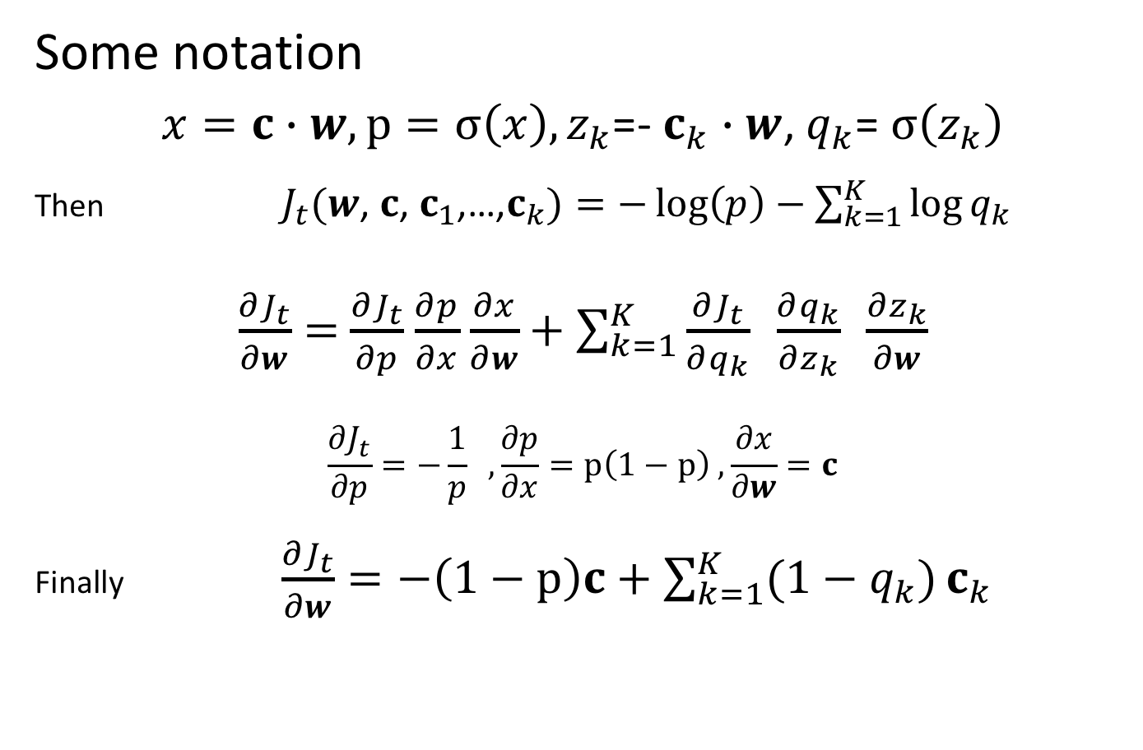
Computing the Derivative
Some notation
$x=c∙$ $w, p=σ\left(x\right),z_{k}$=- $c_{k}$ $∙$ $w$, $q_{k}$= $σ\left(z_{k}\right)$
Then $J_{t}(w$, $c$, $c_{1}$,…,$c_{k})=−\log\left(p\right)−$ $\sum_{k=1}^{K}{\log{q_{k}}}$
$\frac{∂J_{t}}{∂w}=$ $\frac{∂J_{t}}{∂p}$ $\frac{∂p}{∂x}$ $\frac{∂x}{∂w}+\sum_{k=1}^{K}{\frac{∂J_{t}}{∂q_{k}} \frac{∂q_{k}}{∂z_{k}} \frac{∂z_{k}}{∂w}}$
$$\frac{∂J_{t}}{∂p}=−\frac{1}{p} ,\frac{∂p}{∂x}=p\left(1−p\right) , \frac{∂x}{∂w}=c$$
Finally $\frac{∂J_{t}}{∂w}=−\left(1−p\right)c+\sum_{k=1}^{K}{(1−q_{k})}c_{k}$
Notes:
Computing the derivative of the loss function, for updating the model parameters, requires evaluating derivatives along the operators that compose the loss function. This step is part of what is in machine learning commonly called backpropagation. We illustrate the essential steps of this operation for computing $\frac{∂J_{t}}{∂w}$. To that end it is helpful to identify the different components that constitute the loss function and compose then the derivatives of those components using the chain rule. This reveals that the updates to the parameters result in simple operations. As an exercise one can complete the computation for the other derivatives.
.

Slide 66
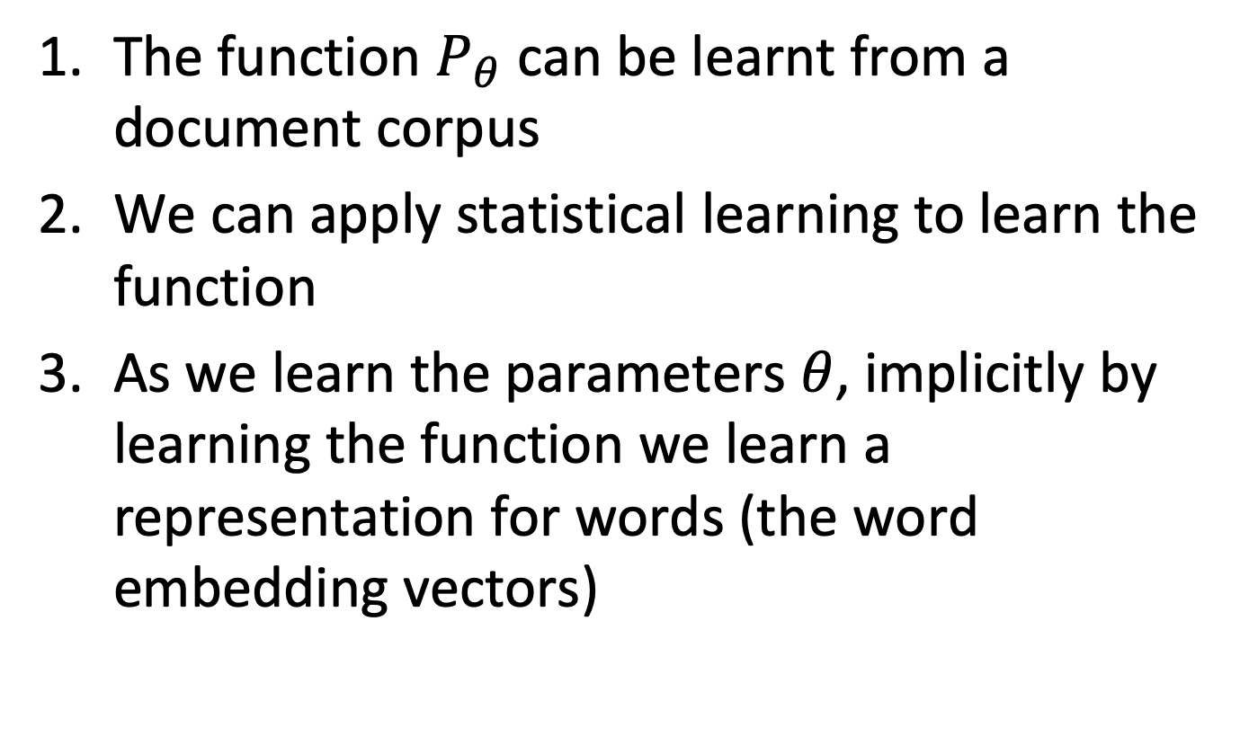
Observations
The function $P_{θ}$ can be learnt from a document corpus
We can apply statistical learning to learn the function
As we learn the parameters $θ$, implicitly by learning the function we learn a representation for words (the word embedding vectors)

Slide 67
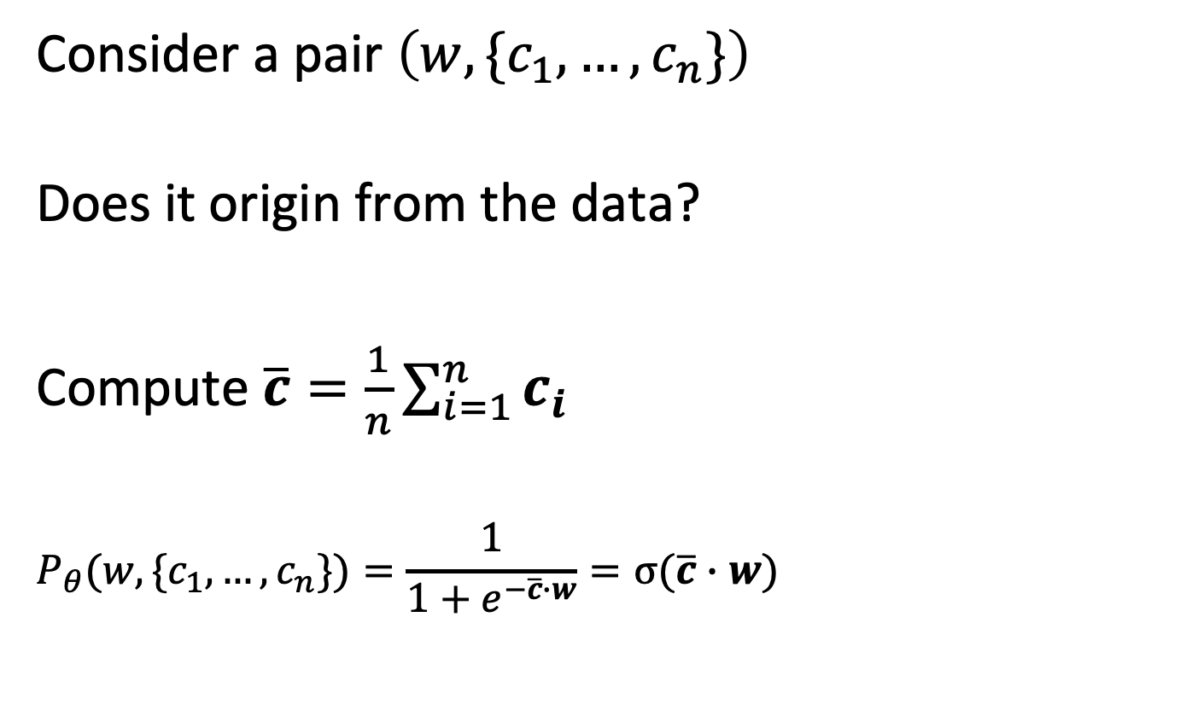
CBOW Model
Consider a pair $\left(w, \{c_{1},…,c_{n}\}\right)$
Does it origin from the data?
Compute $\overline{c}=\frac{1}{n}\sum_{i=1}^{n}{c_{i}}$
$$P_{θ}(w,\{c_{1},…,c_{n}\})=\frac{1}{1+e^{−\overline{c}∙w}}=σ(\overline{c}∙w)$$
Notes:
In the CBOW model, the idea is to predict from a complete context a corresponding word. We can formulate this similarly as we did for the skipgram model, only that we use a set of context words. To take into account the set of context wrods, we take the average vector of their representation, to determine the similarity of the context with the target word w. The rest of the processing proceeds as for the skipgram model.

Slide 68
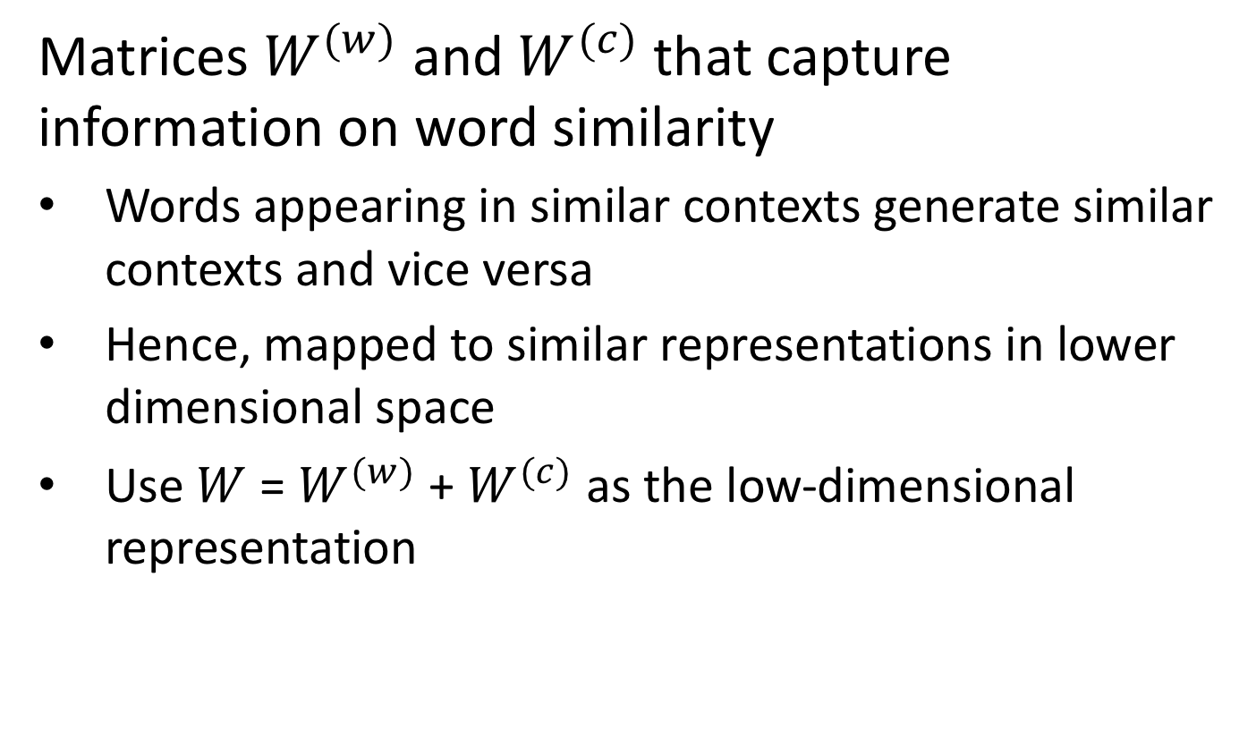
Result
Matrices $W^{(w)}$ and $W^{(c)}$ that capture information on word similarity
Words appearing in similar contexts generate similar contexts and vice versa
Hence, mapped to similar representations in lower dimensional space
Use $W$ = $W^{(w)}$ + $W^{(c)}$ as the low-dimensional representation
Notes:
As a result we obtain two models mapping words into a low dimensional space for different reasons. In practice, the final model is constructed as the sum of the two matrices. Though, there exists no theoretical insight, why exactly this models work well, practice shows that they are organizing words in interesting ways, capturing many semantic and syntactic relationships.

Slide 69
Comments
There exists an alternative approach to learning using hierarchical softmax (different loss functions)
Uses the original formulation of the approach
Negative sampling is faster
CBOW produces better results for frequent terms, skipgram for rare terms
Notes:
The approaches that we presented avoided the use of the softmax functions to generate probability distributions. There exist implementations of the approach as we introduced initially, based on a method called hierarchical softmax. This method is based on a hierarchical aggregation of the softmax values, which makes the problem computationally more tractable. Still negative sampling is the faster approach.
Emperically, CBOW produces better representations for frequent terms, whereas skipgram works better for rare terms.

Slide 70
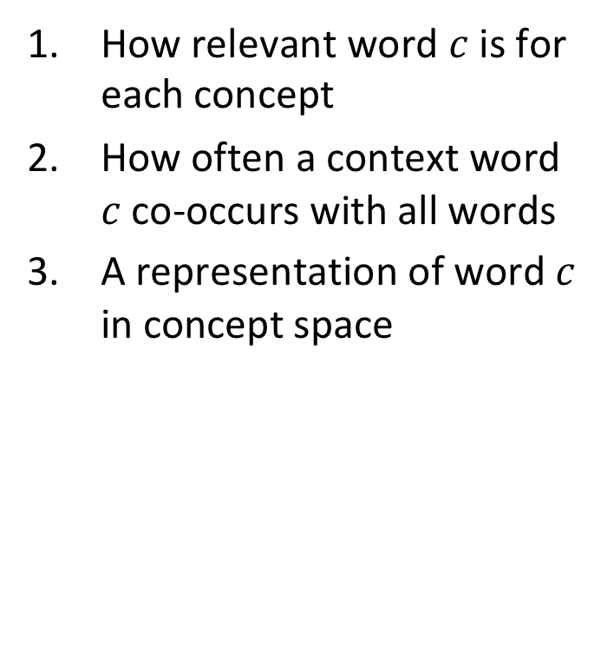
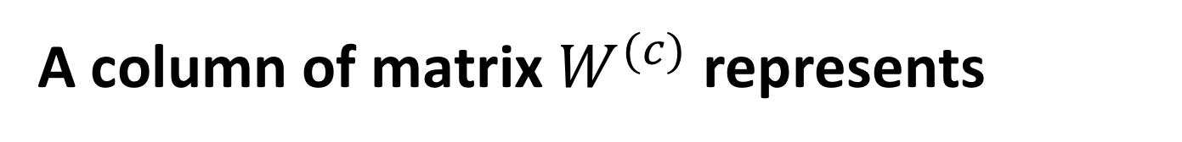
A column of matrix $W^{(c)}$ represents
How relevant word $c$ is for each concept
How often a context word $c$ co-occurs with all words
A representation of word $c$ in concept space

Slide 71
A word embedding for given corpus …
depends only on the dimension d
depends on the dimension d and number of iterations in gradient descent
depends on the dimension d, number of iterations and chosen negative samples
there are further factors on which it depends

Slide 72
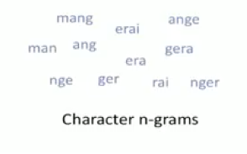
Fasttext
Fasttext introduces the idea of using word n-grams (phrases) and subword embeddings
Build embeddings for character n-grams
Enable processing of unseen words
Example (in French): mangerai
Notes:
The word embedding models we have presented where based on the assumption that the vocabulary consists of the words found in the text corpus. Fasttext is a variant of word embeddings that has been developed by Facebook research. It incorporates in particular two important ideas:
The use of word n-grams, respective phrases: often phrases carry a different meaning than their constituent words. Considering phrases (that are sufficiently frequent) can help to produce better representations of text and capture meaning that cannot be assigned to the constituents of the phrase. As an extreme example one might consider the phrase “The Who” which designates a rock band, whereas the constituent words have no meaning that would be related to music in any way.
The use of character n-grams: many languages, e.g. latin languages, have complex grammatical systems with similar word variations. Often some of them might even not occur in a training corpus. By using so-called subword embeddings the meaning identified for seen words, can so be transferred also to unseen works. This also works across languages, as often languages inherit expressions from foreign languages, or words are same or similar across different languages.

Slide 73
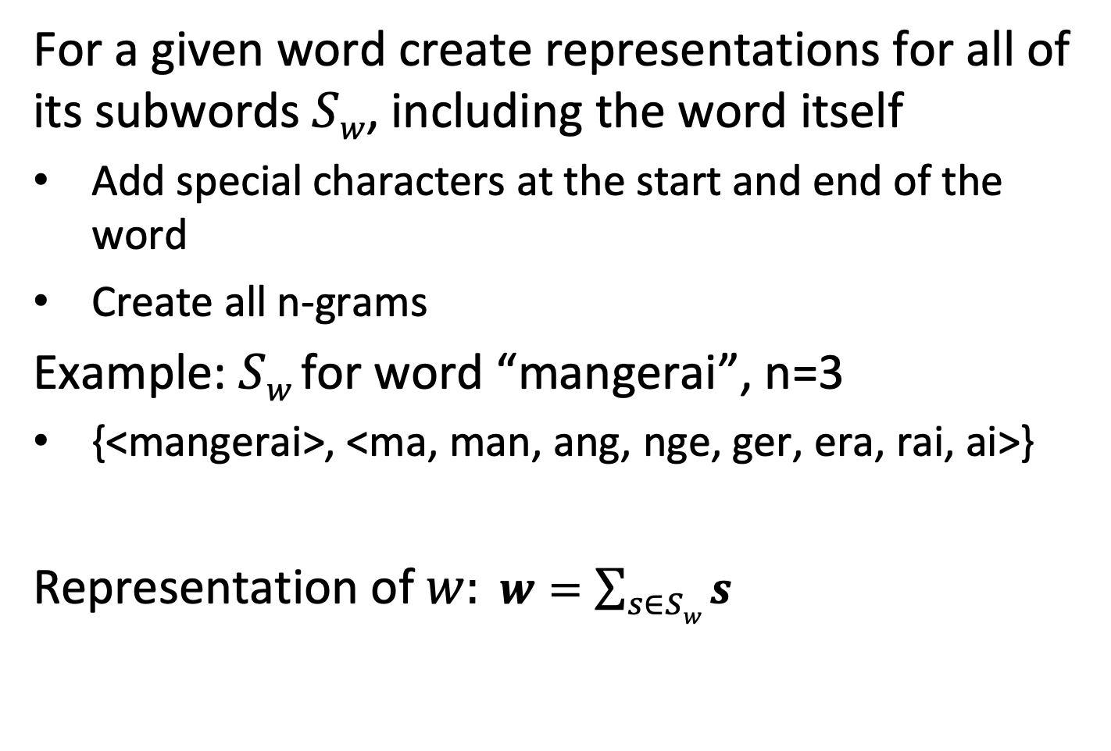
Subword Embeddings
For a given word create representations for all of its subwords $Sw$, including the word itself
Add special characters at the start and end of the word
Create all n-grams
Example: $Sw$for word “mangerai”, n=3
{<mangerai>, <ma, man, ang, nge, ger, era, rai, ai>}
Representation of $w: w=\sum_{s∈Sw}{s}$
Notes:
When using subword embeddings, the representation of a word is aggregated of the representation of all of its constituent n-grams, by adding up the n-gram representations.

Slide 74
Byte Pair Encoding (BPE)
Subword embeddings potentially generate large numbers of possible tokens, many of which are not useful
Large vocabulary implies training the model becomes expensive
BPE allows to create smaller vocabularies, while capturing essential subword information
Statistically analyze text for frequent character sequences
Replace frequent sequences by tokens
Notes:
When using for subword embeddings character n-grams one faces the problem that the number of tokens, i.e. the size of the vocabulary, may become very large, which in turn makes training the models very expensive. In addition, many of the tokens are rare and potentially not very useful. In order to address this problem a method called byte pair encoding is used in order to obtain smaller vocabularies and select only frequent subwords. For this method, first the text needs to be analysed to determine the frequent tokens.

Slide 75
Example BPE
“Do Do! Do! Do! Do? Do! Done Done! Done? Done.”
All subwords of size n=2 (character 2-grams)
{Do, o!, o?, o., on, ne, e!, e?, e.}
Better solution
{Do, Do!, Done, !, ?, .}
Tokenized text
[Do, Do!, Do!, Do!, Do, ?, Do!, ., Done, Done, !, Done, ?, Done, .]
Notes:
This example illustrates the idea of BPW. Instead of blindly selecting all character n-grams, a set of frequent n-grams is chosen and used to tokenize the text.

Slide 76
BPE Algorithm
Add word boundaries
“Do</w>Do!</w>Do!</w>Do!</w>Do?</w>Do!</w>Done</w>Done!</w>Done?</w>Done.”
Initial Vocabulary V = all characters
while i < max_iterations
determine most frequent pair of tokens
add pair to V as a new token
update token frequencies
i = i+1
Notes:
For running the BPW algorithm first a special token for word boundaries is added (in this case </w>).
The BPE algorithm proceeds iteratively.
It determines in every iteration the most frequent pair of tokens and groups to create a new token. Then token frequencies are updated with the new set of tokens. The algorithm terminates after a predetermined number of tokens has been created.
In order to determine token frequencies, the algorithm can first scan the document corpus to determine all n-gram frequencies (up to a given bound).

Slide 77
BPE Example
“Do</w>Do!</w>Do!</w>Do!</w>Do?</w>Do!</w>Done</w>Done!</w>Done?</w>Done.”
V = {</w>,D,o,!,?,n,e,.}
i = 1, most frequent pair: D,o: 9
V = {</w>,D,o,!,?,n,e,.,v0 = Do}
New text: v0</w>v0!</w>v0!</w>v0!</w>v0?</w>v0ne</w>v0ne!</w>v0ne?</w>v0ne.
Tokenized text:
[Do, Do, !, Do, !, Do, !, Do,?, Do, !, n, e, Do, n, e , !, Do, n, e, ?, Do, n, e, .]
i = 2: most frequent pair: !, </w>: 5
V = {</w>,!</w>, D,o,!,?,n,e,.,v0 = Do, v1 = !</w>}
New text:
v0</w>v0v1v0v1v0v1v0?</w>v0v1v0ne</w>v0nev1v0ne?</w>v0ne.]
Tokenized text:
[Do, Do, !, Do, !, Do, !, Do,?, Do, !, n, e, Do, n, e , !, Do, n, e, ?, Do, n, e, .]
Notes:
Here we illustrate the first two steps of the algorithm. Note that in the second step the tokenization does not change, as we introduce a token corresponding to !</w>. Having tokens that combine a character n-gram with a word boundary is important to identify character sequences that would typically occur at the end (or beginning) of a word and to distinguish them from character sequences that occur in the middle of a word.
For example, the sequence “ed” at the end of of an English word (like “worked”) implies a different meaning of this character sequences at the beginning of a word (like “education”) or in the middle of a word (like “medicine”)

Slide 78
Alternative Approaches
GLOVE: exploits the following observation
“solid” is related to “ice” but unrelated to “steam”: we expect a larger ratio of co-occurrence probabilities
“gas” is related to “steam” but unrelated to “ice”: we expect a smaller ratio of co-occurrence probabilities
”water” is related to both “ice” and “steam”: we expect a ratio of co-occurrence probabilities that is close to 1 (both large)
A random word that is unrelated to both “ice” and “steam”: we expect a ratio of co-occurrence probabilities that is close to 1 (both small)
Notes:
The skipgram and CBOW models are one variant among a number of similar models that have been proposed recently to create word representations that capture semantics.
One interesting model is GLOVE, which is based on the observation that ratios of probabilities can be used to capture semantic relationships among terms. For example, the term solid is much more likely to co-occur with ice, than with water, and similarly steam co-occurs much more likely with gas than with ice. On the other hand, water co-occurs frequently with both. In the Glove paper it is stated: “Compared to the raw probabilities, the ratio is better able to distinguish relevant words (solid and gas) from irrelevant words (water and fashion) and it is also better able to discriminate between the two relevant words” This may be interpreted as follows: the ratio of probabilities captures the semantics of the meaning of solid and gas, without referring to specific case in which this meaning occurs, namely the context of water.

Slide 79
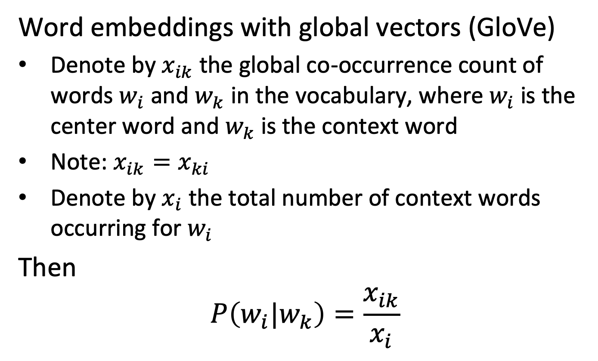
Global Co-occurrence Count
Word embeddings with global vectors (GloVe)
Denote by $x_{ik}$ the global co-occurrence count of words $w_{i}$ and $w_{k}$ in the vocabulary, where $w_{i}$ is the center word and $w_{k}$ is the context word
Note: $x_{ik}=x_{ki}$
Denote by $x_{i}$ the total number of context words occurring for $w_{i}$
Then
$$P\left(w_{i}|w_{k}\right)=\frac{x_{ik}}{x_{i}}$$
Notes:
In order to consider the property illustrated before, Glove uses the global occurrence counts among words. In this way it incorporates into the model also global statistics on the co-occurrence of words, different to skipgram/CBOW which exploit local information. Using the global co-occurrence counts we can determine the co-occurrence probability.

Slide 80
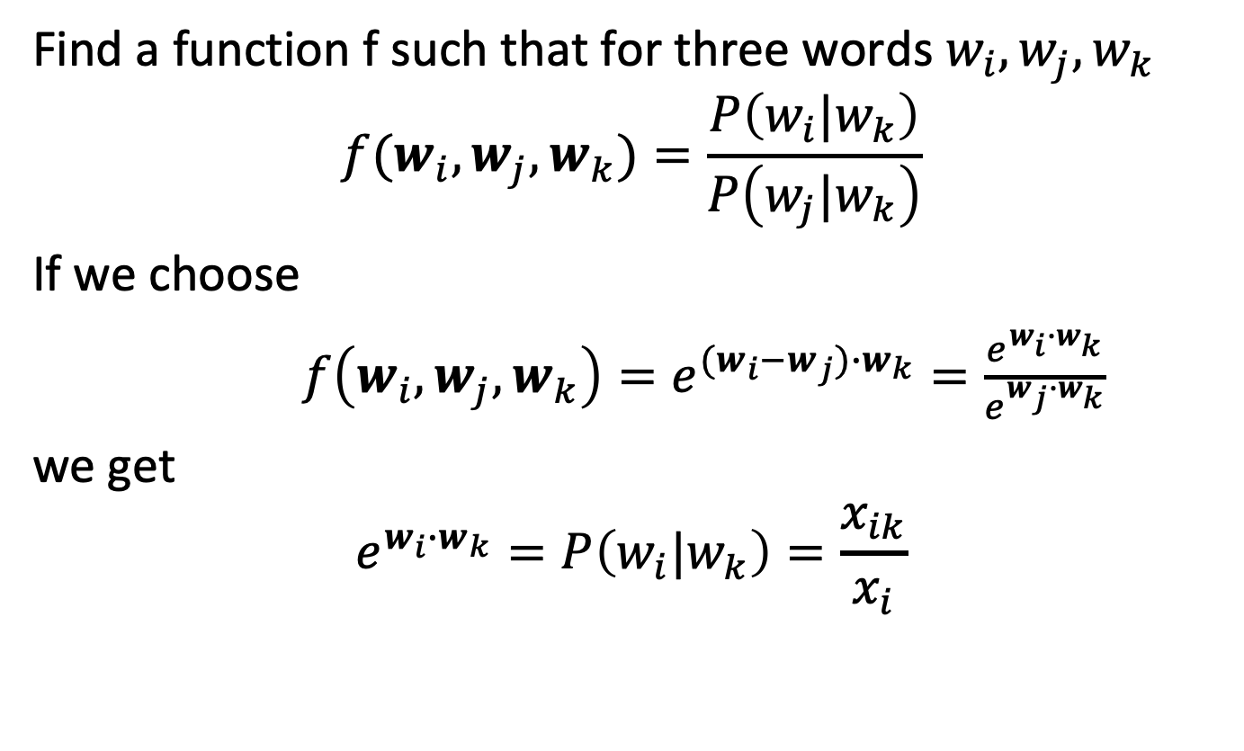
Modeling Ratios
Find a function f such that for three words $w_{i},w_{j},w_{k}$
$$f(w_{i},w_{j},w_{k})=\frac{P\left(w_{i}|w_{k}\right)}{P\left(w_{j}|w_{k}\right)}$$
If we choose
$f\left(w_{i},w_{j},w_{k}\right)=e^{{(w}_{i}−w_{j})∙w_{k}}=\frac{e^{w_{i}∙w_{k}}}{e^{w_{j}∙w_{k}}}$
we get
$$e^{w_{i}∙w_{k}}=P\left(w_{i}|w_{k}\right)=\frac{x_{ik}}{x_{i}}$$
Notes:
In order to formalize the observation that we have described, we need to design a function that captures rations between co-occurrence probability. We are free to choose any function f for that purpose. For technical consideration in Glove this function has been chosen to be of a very specific form, as the exponential of the scalar product of the difference of the representation of two (context) words with the representation of a a given word. When using this form of function, it follows that the conditional probability of co-occurrence is modelled as the exponential for the scalar product of the representations of the two words.

Slide 81
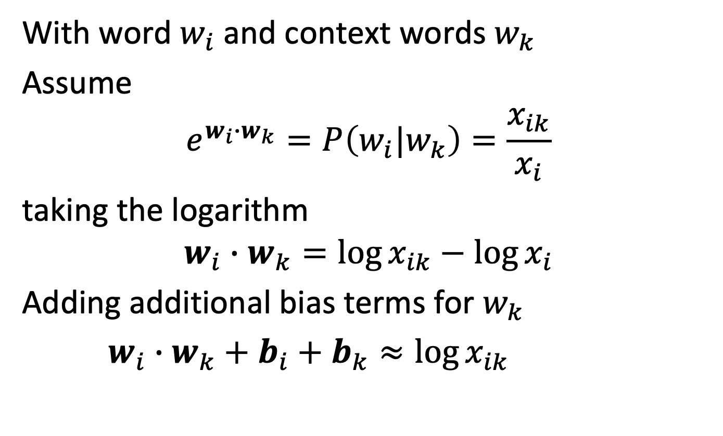
Glove Loss Function
With word $w_{i}$ and context words $w_{k}$
Assume
$$e^{w_{i}∙w_{k}}=P\left(w_{i}|w_{k}\right)=\frac{x_{ik}}{x_{i}}$$
taking the logarithm
$$w_{i}∙w_{k}=\log{x_{ik}−\log{x_{i}}}$$
Adding additional bias terms for $w_{k}$
$w_{i}∙w_{k}+b_{i}+b_{k}≈\log{x_{ik}}$
Notes:
Once we have defined the condition that the representation of words has to satisfy, we can derive a loss function. By taking the logarithm we obtain a linear relationship between the scalar product and the statistics on co-occurrence. Apart from the co-occurrence frequencies, also a term for each word is introduced in the loss function (this is design decision that has been taken by the authors of Glove).

Slide 82
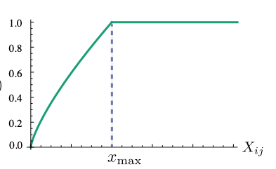
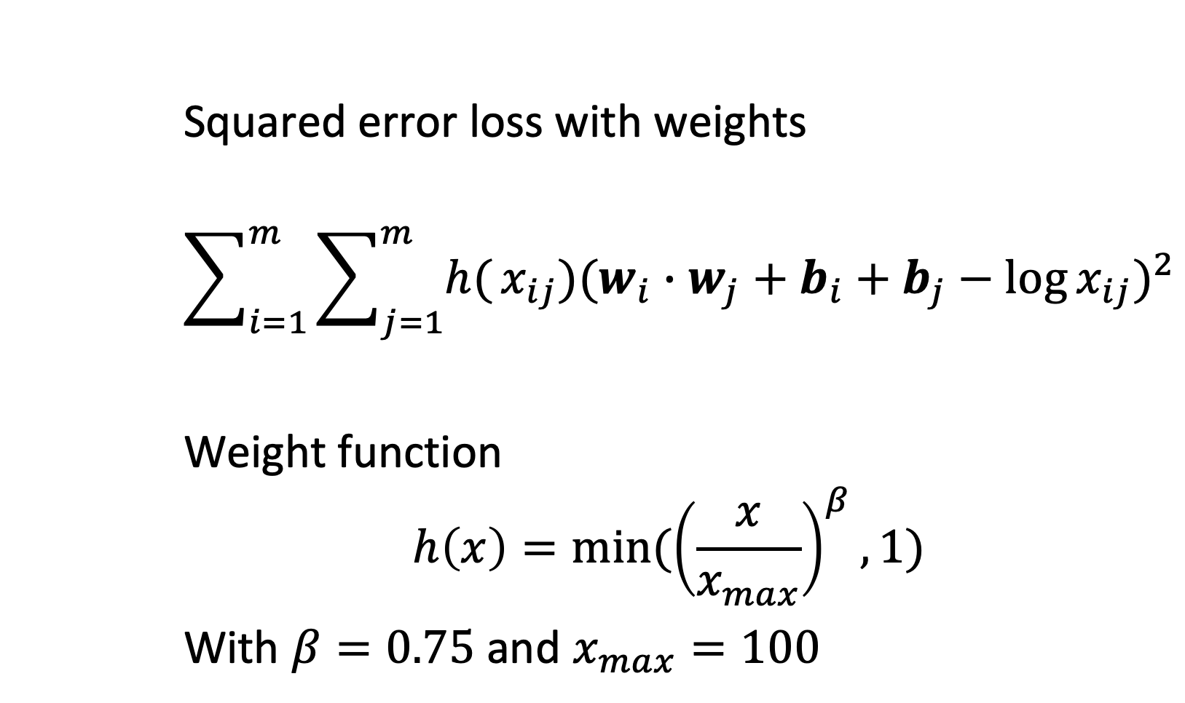
Glove Loss Function
Squared error loss with weights
$$\sum_{i=1}^{m}{\sum_{j=1}^{m}{h(}}x_{ij}){(w_{i}∙w_{j}+b_{i}+b_{j}−\log{x_{ij}})}^{2}$$
Weight function
$$h\left(x\right)={min⁡(\left(\frac{x}{x_{max}}\right)}^{β},1)$$
With $β=0.75$ and $x_{max}=100$
Notes:
Finally the loss function is enhanced by introducing a weight function h. It aims at resolving two problems:
If x_ij equals zero, the loss function would be ill-defined. The limit lim_x->0 f(x) log^2(x) is finite, making the function well-defined
Small values of x_ij carry in general less information and should thus have lower weight.

Slide 83
Properties of Word Embeddings
Similar terms are clustered
Syntactic and semantic relationships encoded as linear mappings
Dimensions can capture meaning
Notes:
Word Embeddings have received recently a lot of attention as they exhibit fascinating capacity to capture different types of relationships among words. We will illustrate some of those in the following.

Slide 84
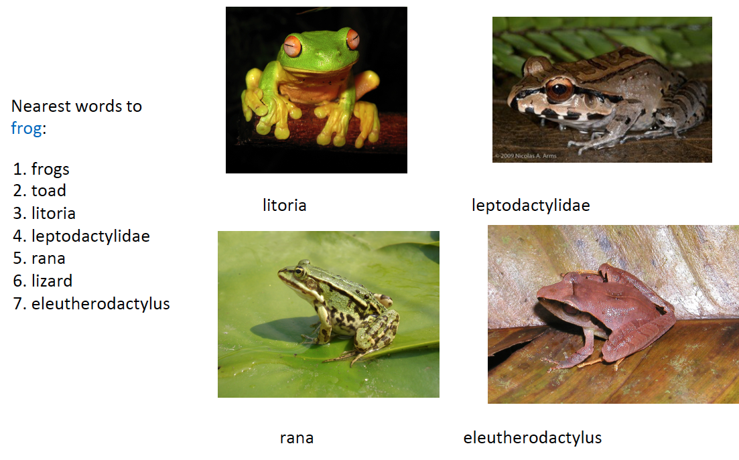
Glove: Nearest words to Frog
Notes:
A first property is that similar words are grouped together. Here is a nice example, produced with Glove, that illustrates the point. (The underlying data is from Wikipedia).

Slide 85
Syntactic Relationships
Notes:
Word embeddings also capture syntactic relationships, like singular-plural or comparative and superlative, as shown here. This type of visualizations is obtained by projecting from the d-dimensional word embedding space (appropriately) into a 2-dimensional space.

Slide 86
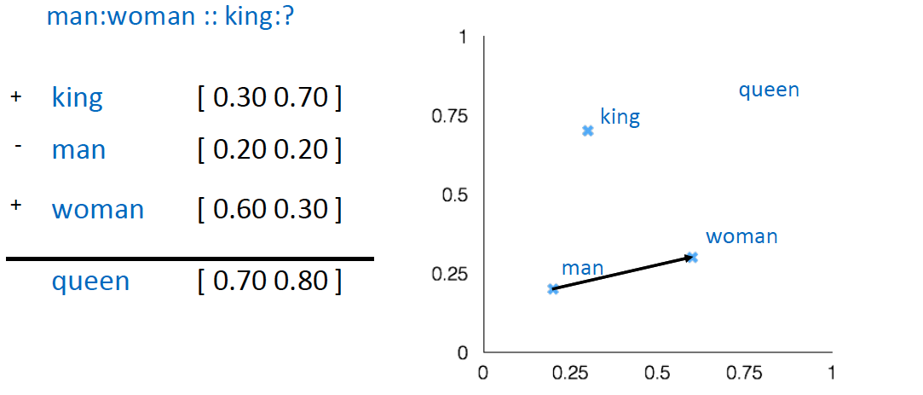
Word Analogies: semantic relationships
Notes:
Even more interestingly, word embeddings enable “computing” with relationships (this is called the word analogy task). Analogies translate into linear mappings!

Slide 87
Semantic Dimensions
negative
natural
positive
artificial
Notes:
Furthermore, word embeddings can capture semantic meaning in dimensions. In this example, data on nutrition has been analyzed and terms indicating qualities of foods are extracted. The word embedding clearly organizes it according to properties that are human understandable, e.g. natural vs. artificial ingredients.

Slide 88
Use of Word Embedding Models
Document Search
Use word embedding vectors as document representation
Thesaurus construction and taxonomy induction
Search engine for semantically analogous / related terms
Document classification
Use of word embedding vectors of document terms as features

Slide 89
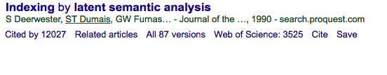
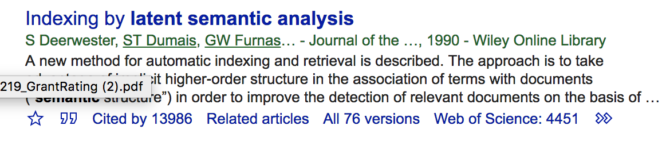

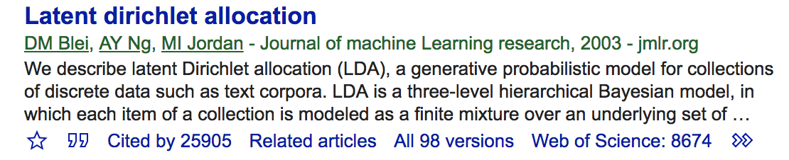
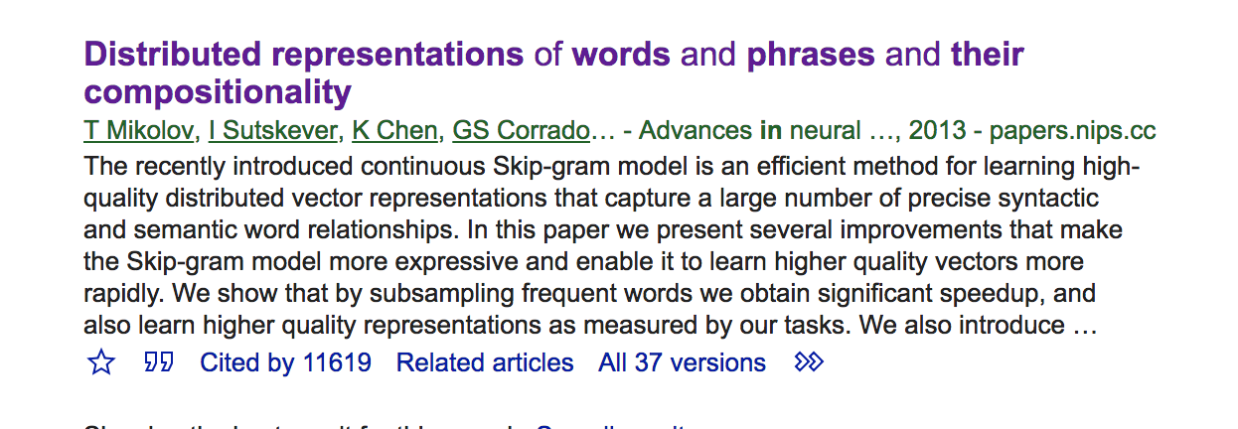
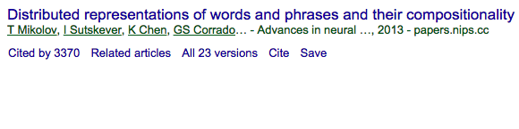
Impact
Latent semantic indexing
Latent Dirichlet allocation
Word embeddings
+2000
+8000
+8000

